Slide 1
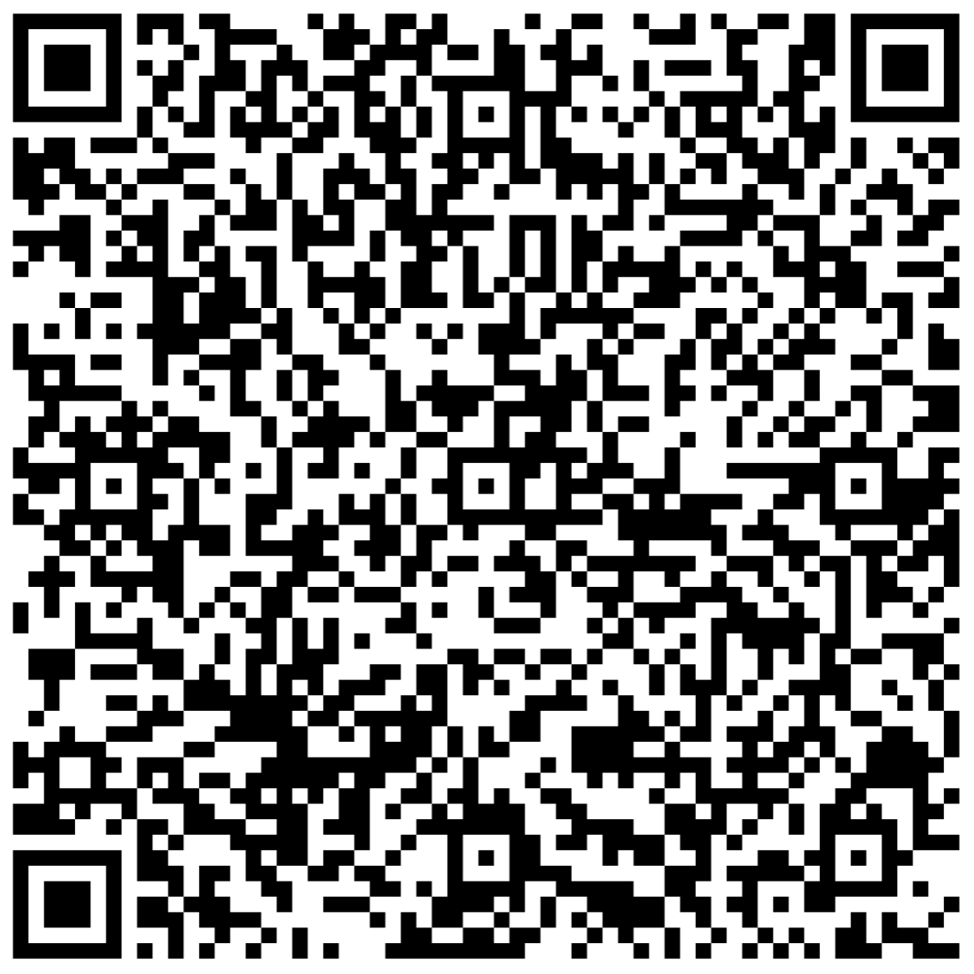

WELCOME! Record attendance below!

Slide 2
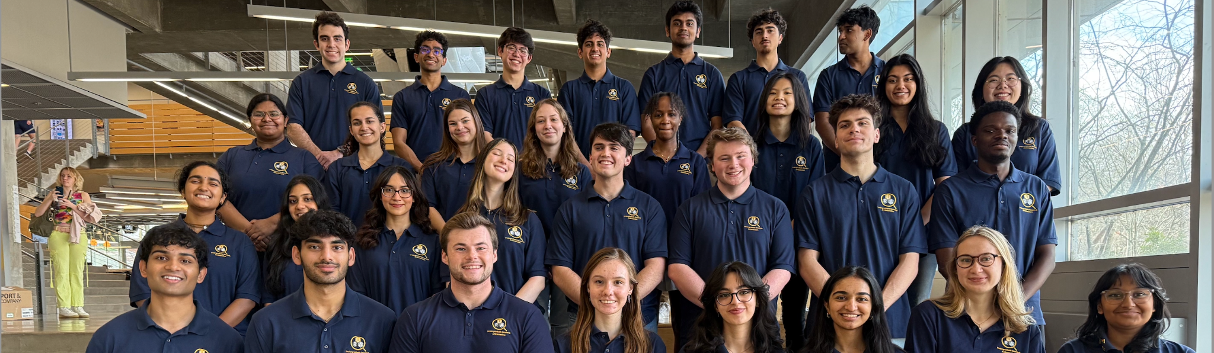


Slide 3
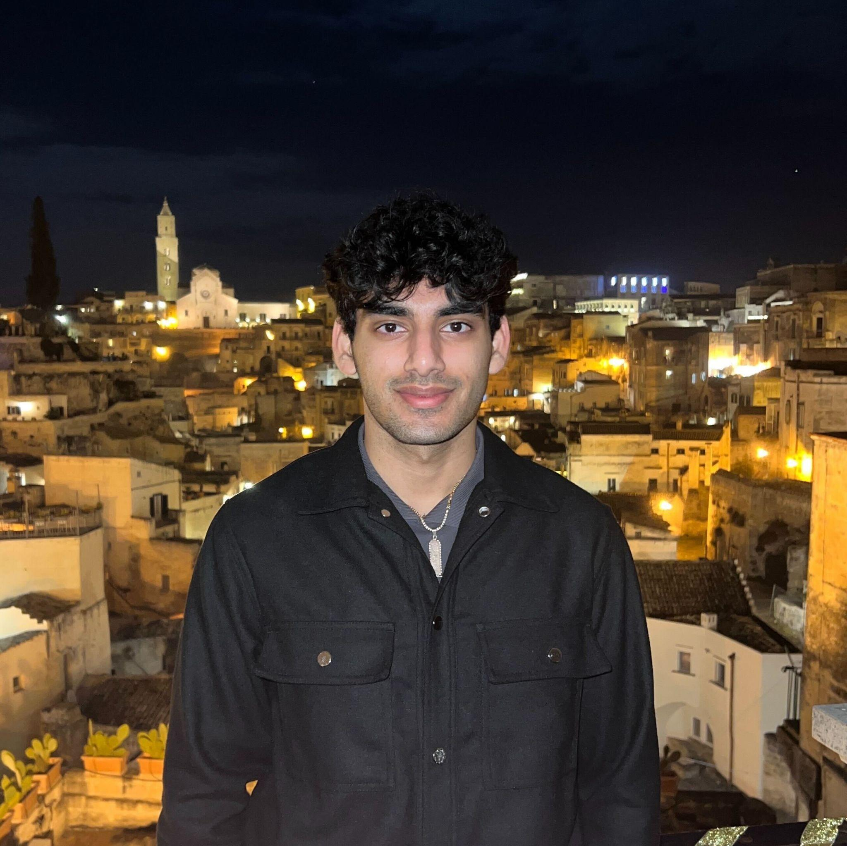
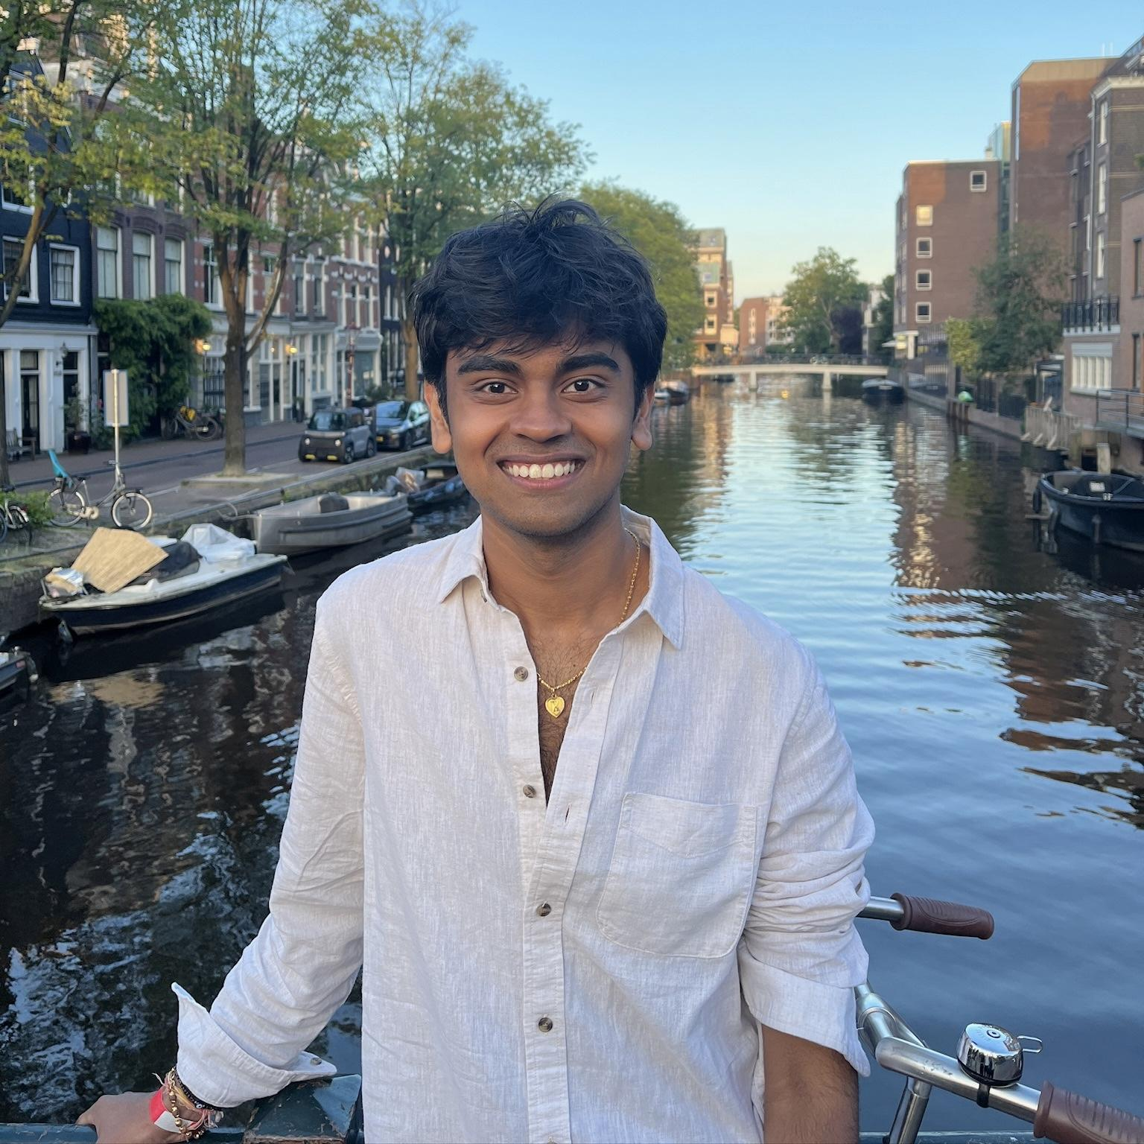
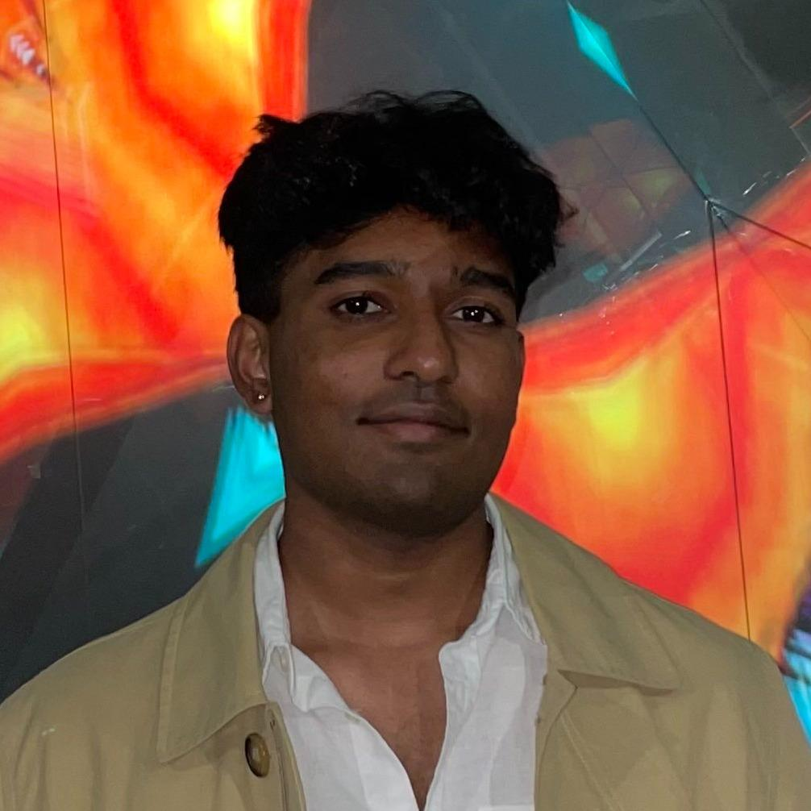
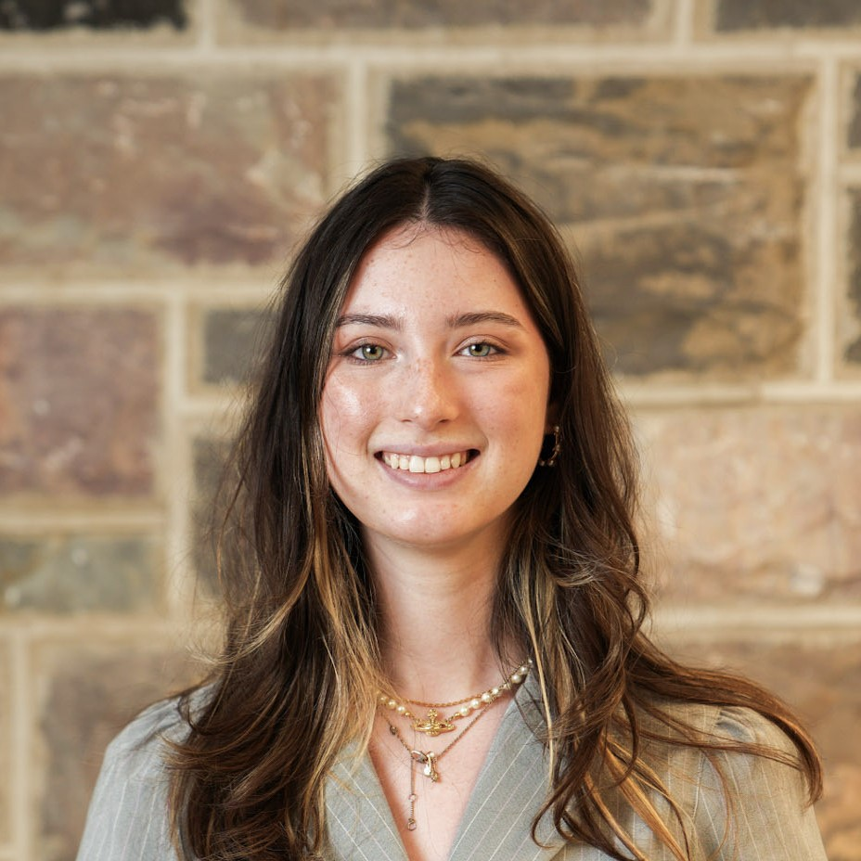
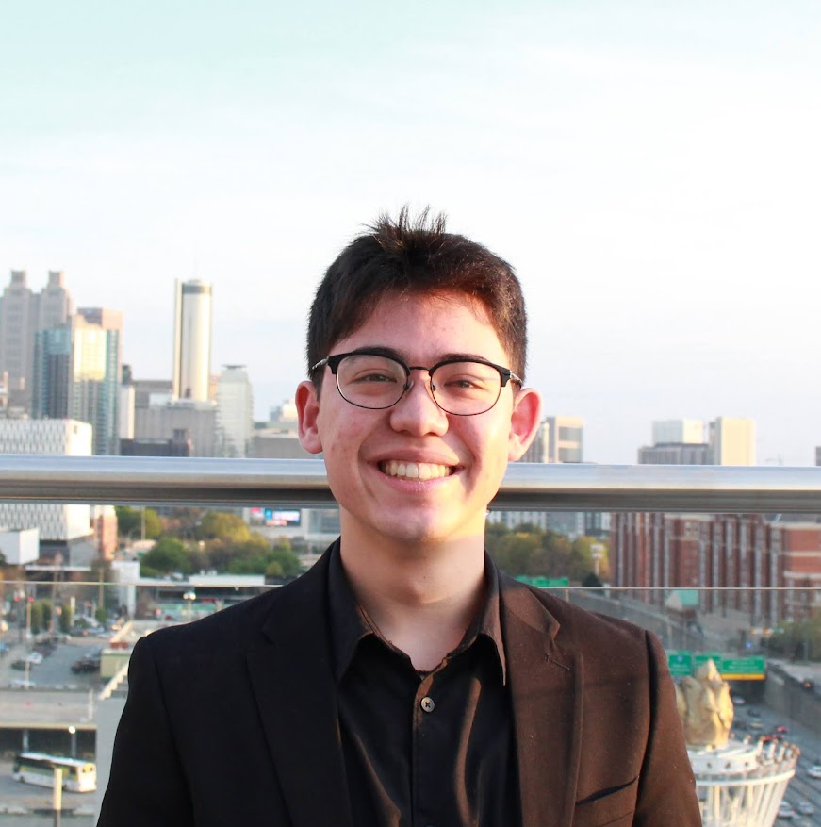
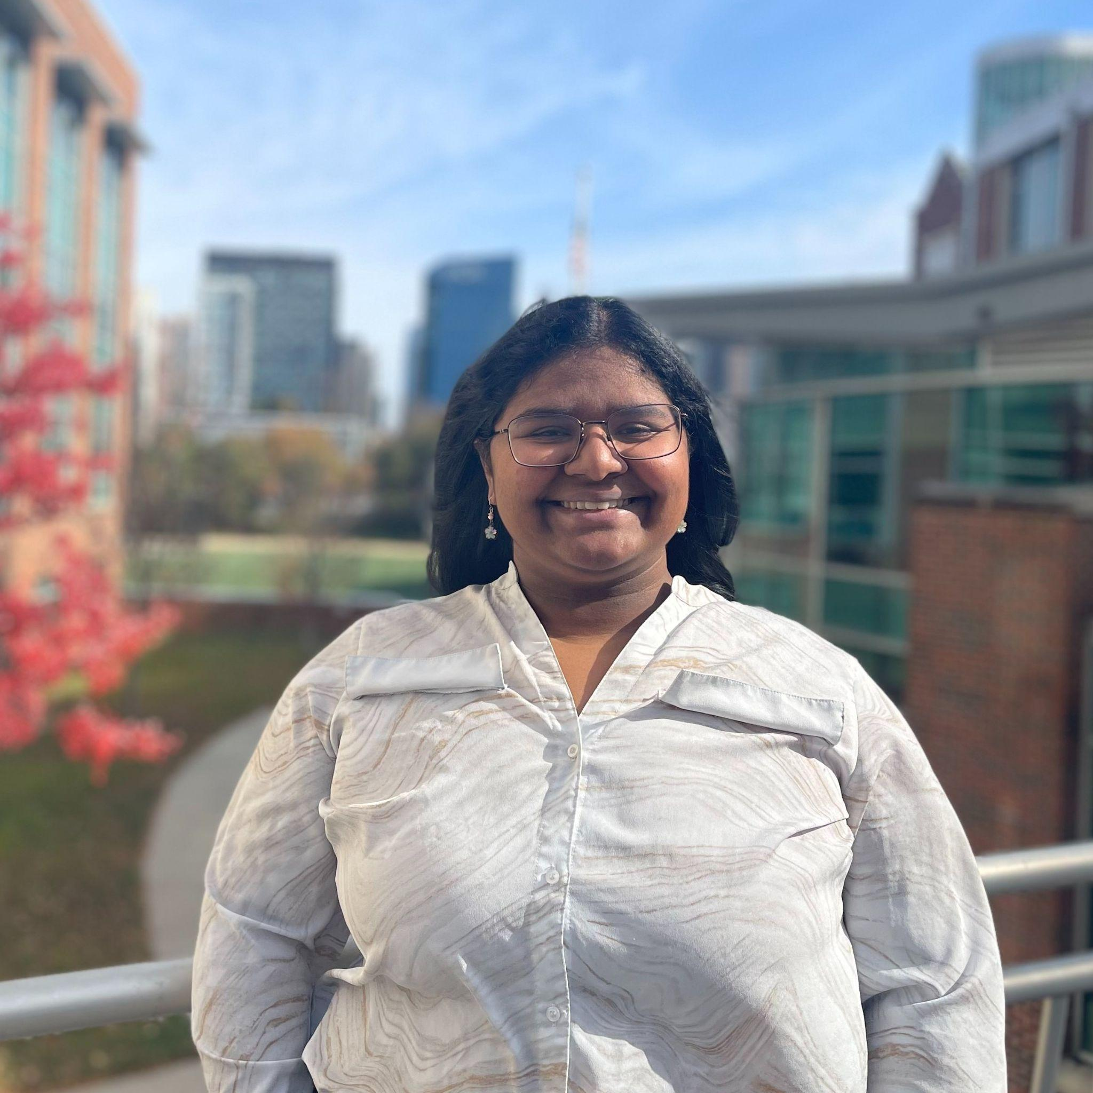
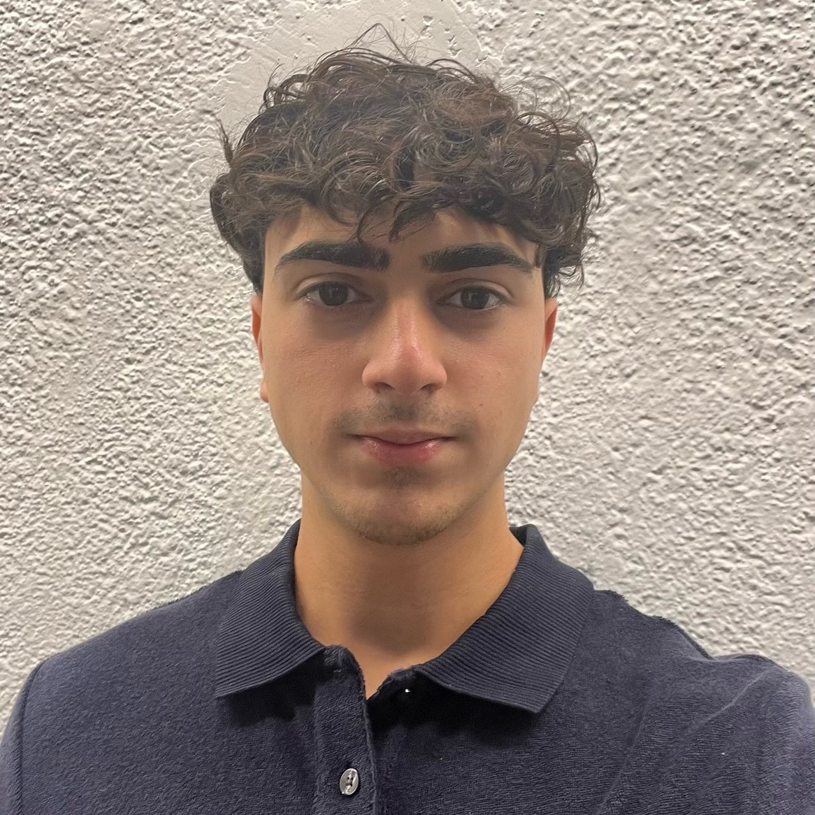
Today’s ambassadors!
Ritvik Panuganti
Karthik Chilakapati
Pranay Ramaswamy
Sophia Schumaecker
Seth Kinoshita
Jagruti Goli
Arya Akbarshahi
President
Neuroscience Major
Research Area: Biomechanics & Motor Neuroscience
VP of Internal Affairs
Aerospace Engineering Major
Research Area: System Modeling of MBSE Projects with SysML
VP of Campus Relations
Biochemistry Major
Research Area: Aggregation pathway kinetics and molecular modelling of Alzheimer's-causing peptides
VP of Outreach
Chemical & Biomolecular Engineering Major
Research Area: Lymphatic Tissue Engineering and Drug Delivery
Ambassador
Biochemistry Major
Research Area: Nanoengineering, Regenerative Medicine, & Chemical Education
On-site Events Chair
Chemistry Major
Research Area: Organic Synthesis Chemistry
Ambassador
Biochemistry Major
Research Area: Immunology

Slide 4
WHO ARE WE?
Undergraduate Research Ambassadors
Help students find research opportunities, improve communication skills, & gain access to valuable resources for undergraduate research
Communicate that research is for everyone & anyone
Encourage multidisciplinary work and involvement
Attend our events throughout the year!

Slide 5

WHY DO RESEARCH?
Connecting classwork concepts to real-world applications
Gain technical experience in specific specializations
Develop soft skills (useful for any position)
Stand out to companies, boost resume for internships/early career

Slide 6
Getting into research timeline
Find labs you are interested in joining!
Meet with someone from the lab and (hopefully) make plans for you joining!
Start your undergraduate research journey!
Contact the labs you’re interested in!

Slide 7
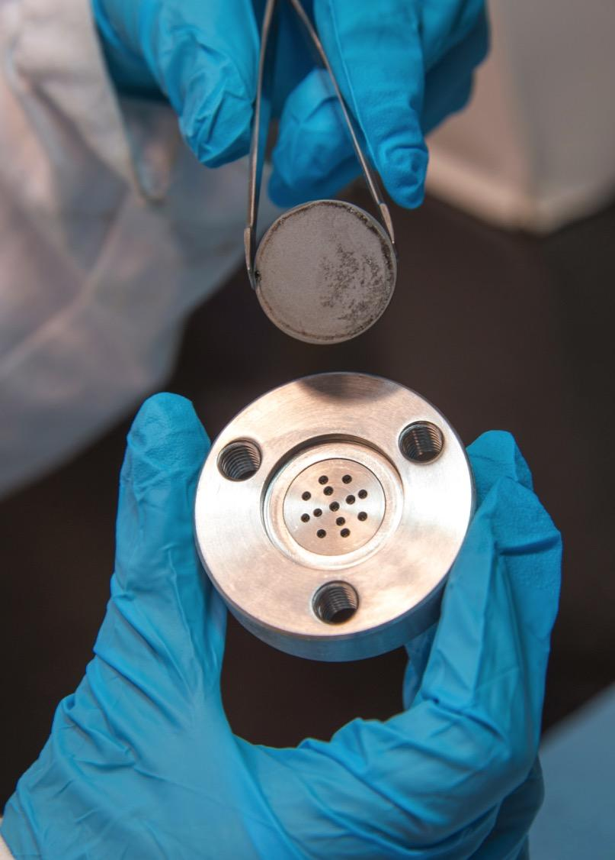
HOW TO BEGIN RESEARCH
Identify research topics and labs you are interested in
Write email and prepare resume
Email professor/graduate student
Meet with lab and establish research expectations

Slide 8
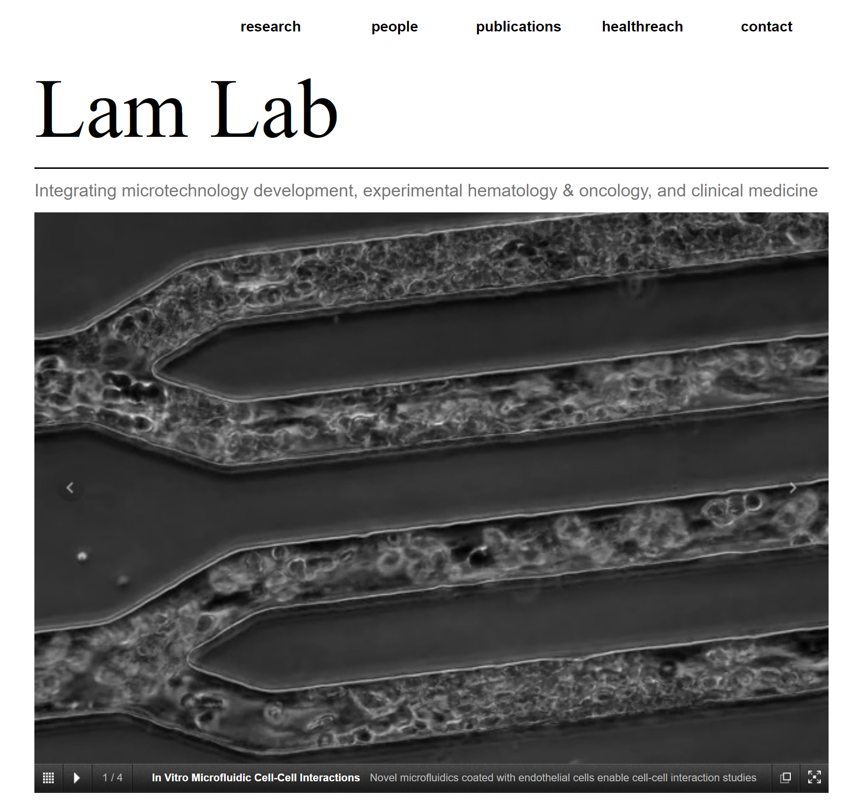
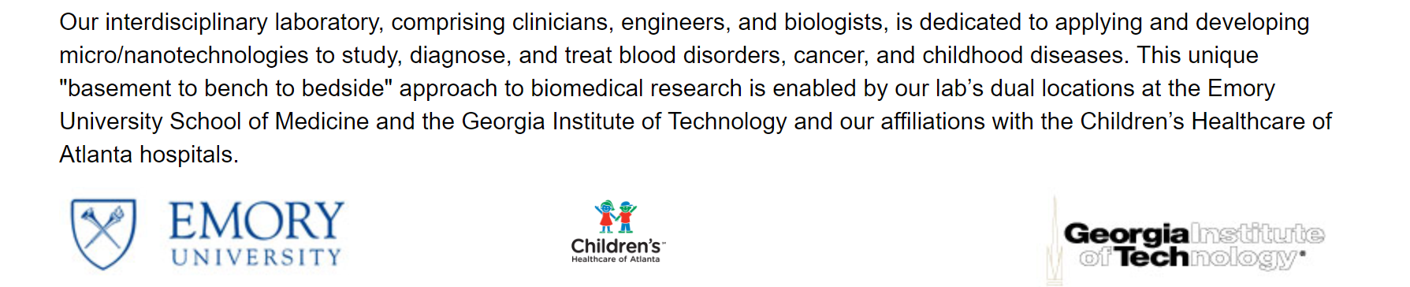
FIND RESEARCH AND LABS
Search for Georgia Tech & Emory labs online
Check PairMe (Indeed for GT research)
Talk to your current professors
Attend URA Virtual Office Hours! Offered Monday through Friday
Notes:
plug office hours

Slide 9
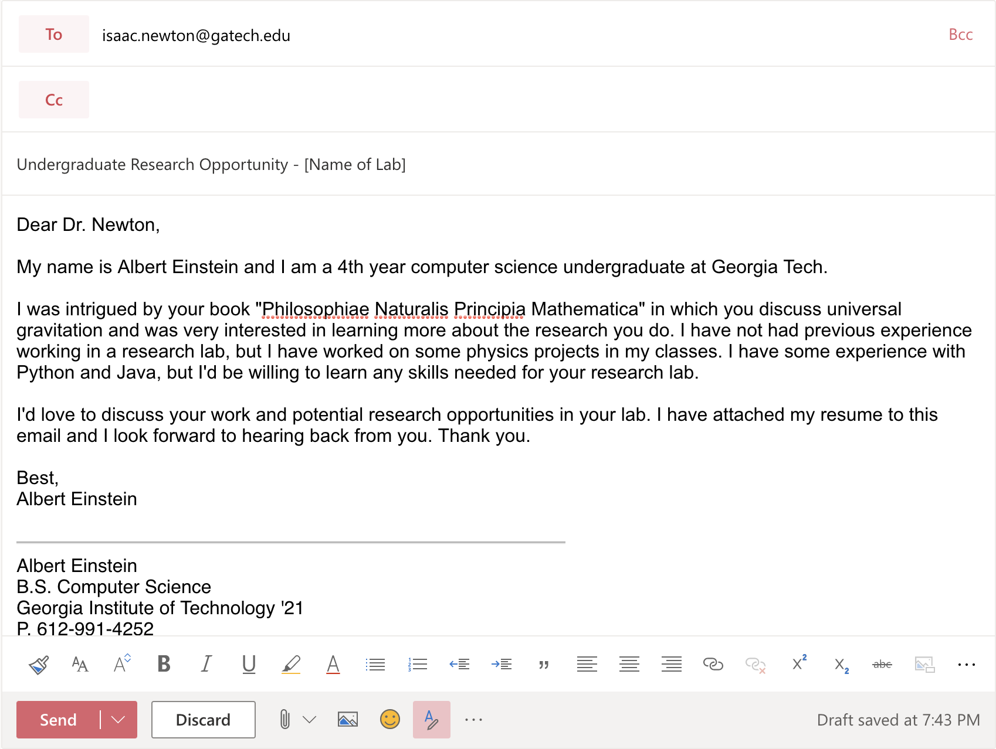
WRITE EMAIL TO PROFESSOR
INTRODUCE YOURSELF
NAME
YEAR
MAJOR
SHOW
YOUR INTEREST IN THEIR WORK
MENTION
INTERESTS
EXPERIENCE
ATTACH
YOUR RESUME

Slide 10
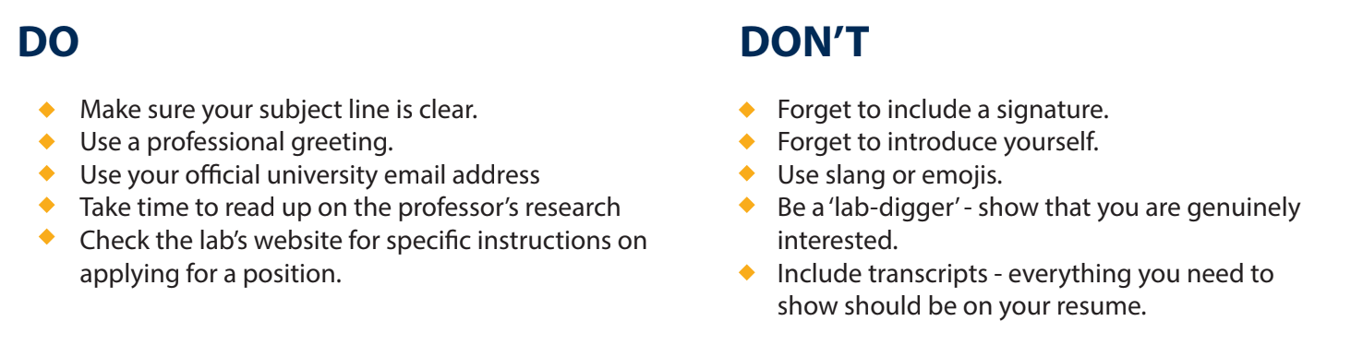
MORE EMAIL TIPS
DO...
DO NOT...
Notes:
make sure to emphasize reading papers

Slide 11

REVIEW EMAIL WITH AMBASSADOR
Need guidance?
Meet 1-on-1 with an ambassador at Office Hours!
Offered every weekday through Calendly

Slide 12

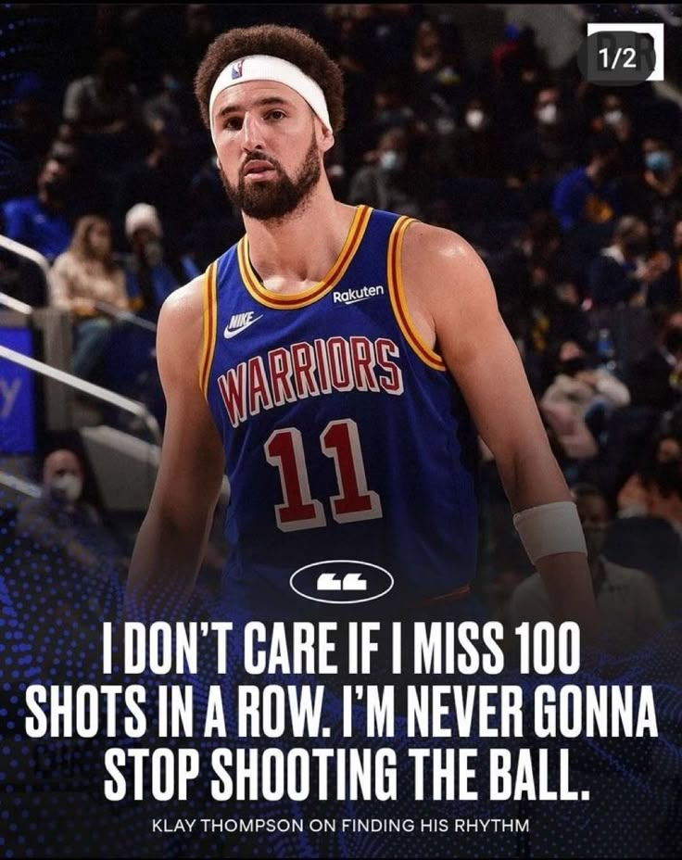
EMAIL SENT! WHAT’S NEXT?
Professor responds! Respond to email to confirm a time and date to meet.
No response :( Re-email professor (after 1-2 weeks) and continue looking at other labs.

Slide 13

MEETING WITH LAB, TOPICS TO DISCUSS
Ask questions about their research
Discuss research project and lab structure
Weekly hours in the lab
Research for credit, pay, or volunteering
Talk to other undergraduates in the lab

Slide 14
RESEARCH OPTIONS
Volunteer - No pay or credit for research, great way to start in a lab with low commitment
Credit - Register and receive credit, 3hr in lab per credit hour
Pay - Register for audit credit, no credit towards major but paid
Notes:
audit for pay will show up on your transcript

Slide 15
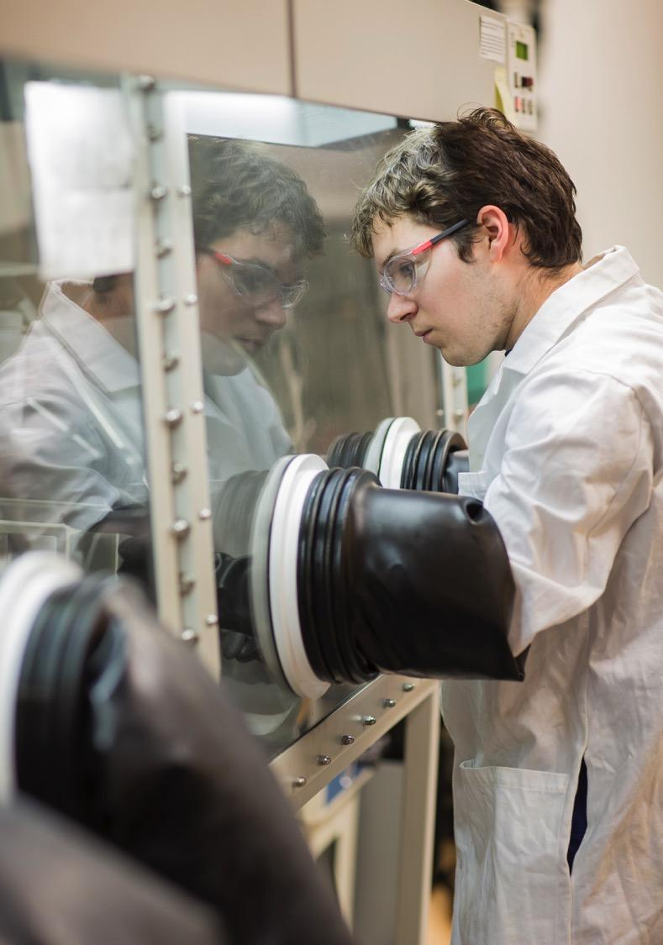
JOIN THE LAB!
After meeting, are you still interested in joining the lab? If yes, there are a few more steps to make it official…
Register for your research
Complete lab training

Slide 16
REGISTER RESEARCH
Register your research by the end of Phase II registration
All majors are different, but usually you will:
Fill out a research form with your PI
Submit it online and then request a permit
Receive permit and register for course
 | 1st / 2nd Year (by credit) | 3rd / 4th Year (by credit)
VOLUNTEER | N/A | N/A
CREDIT | XXXX 2699 | XXXX 4699
PAY | XXXX 2698 | XXXX 4698
Notes:
2699/4699 for Credit, 2698/4698 for Pay

Slide 17
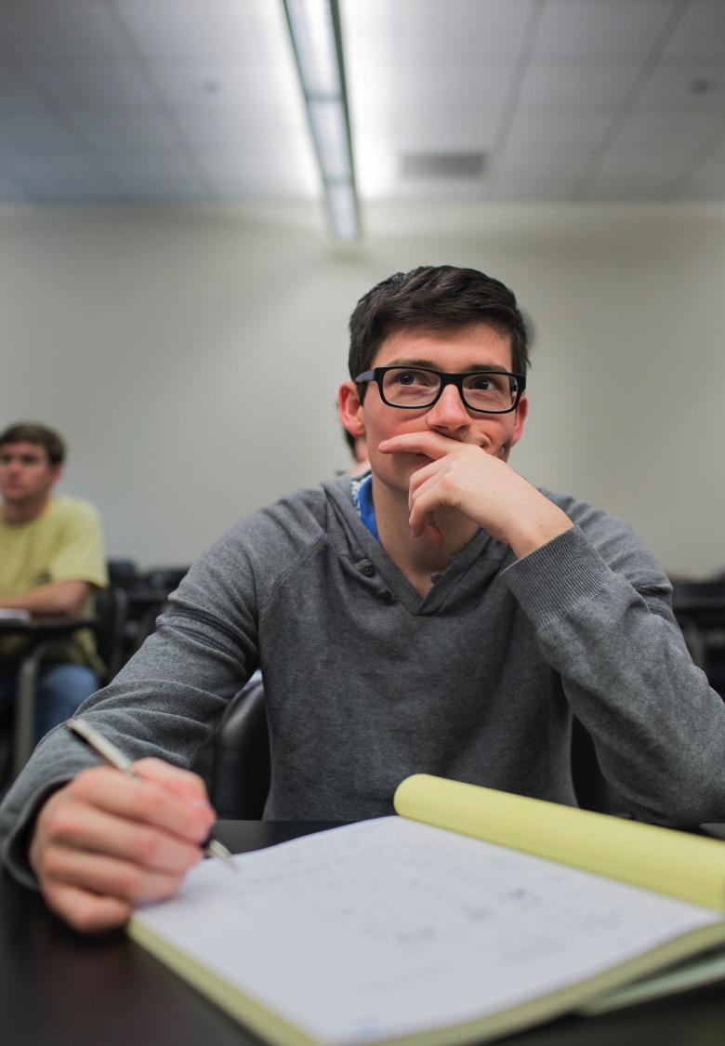

COMPLETE LAB TRAINING
Ask your PI or graduate student what trainings you should complete.
Required training for undergraduate researchers:
Lab Safety 101
Lab-specific required training
Environmental Health and Safety,
https://www.ehs.gatech.edu/

Slide 18
RESEARCH BEGINS
You are now an established undergraduate researcher! Now what?
Be responsible, show up on time, complete assigned work
Look towards future funding and research opportunities
Have fun! Research will arm you will technical and collaborative skills for your future.
Attend more URA events to learn how to make the most of research!

Slide 19
WHAT TO DO AFTER JOINING
(Immediately after) Send them a thank you e-mail and tell them how excited you are to work in the lab!
Get to know your Grad student mentor (if possible) - they are your connection to your PI
Feel out the lab culture
Try to find an undergrad that has experience with the lab to be able to ask questions to
First impressions are everything - do not slack off just because you got in!

Slide 20

NEED HELP? COME TO OFFICE HOURS!
Contacting Faculty & Labs
Help with writing emails and applications for undergraduate research
Interested in joining a lab?
Come talk to us! We have some opportunities for undergraduate research!
Writing
Help with writing research proposals, grants, and/or academic papers

Slide 21
Now …
Hear about research personally from some of our fabulous ambassadors!

Slide 22
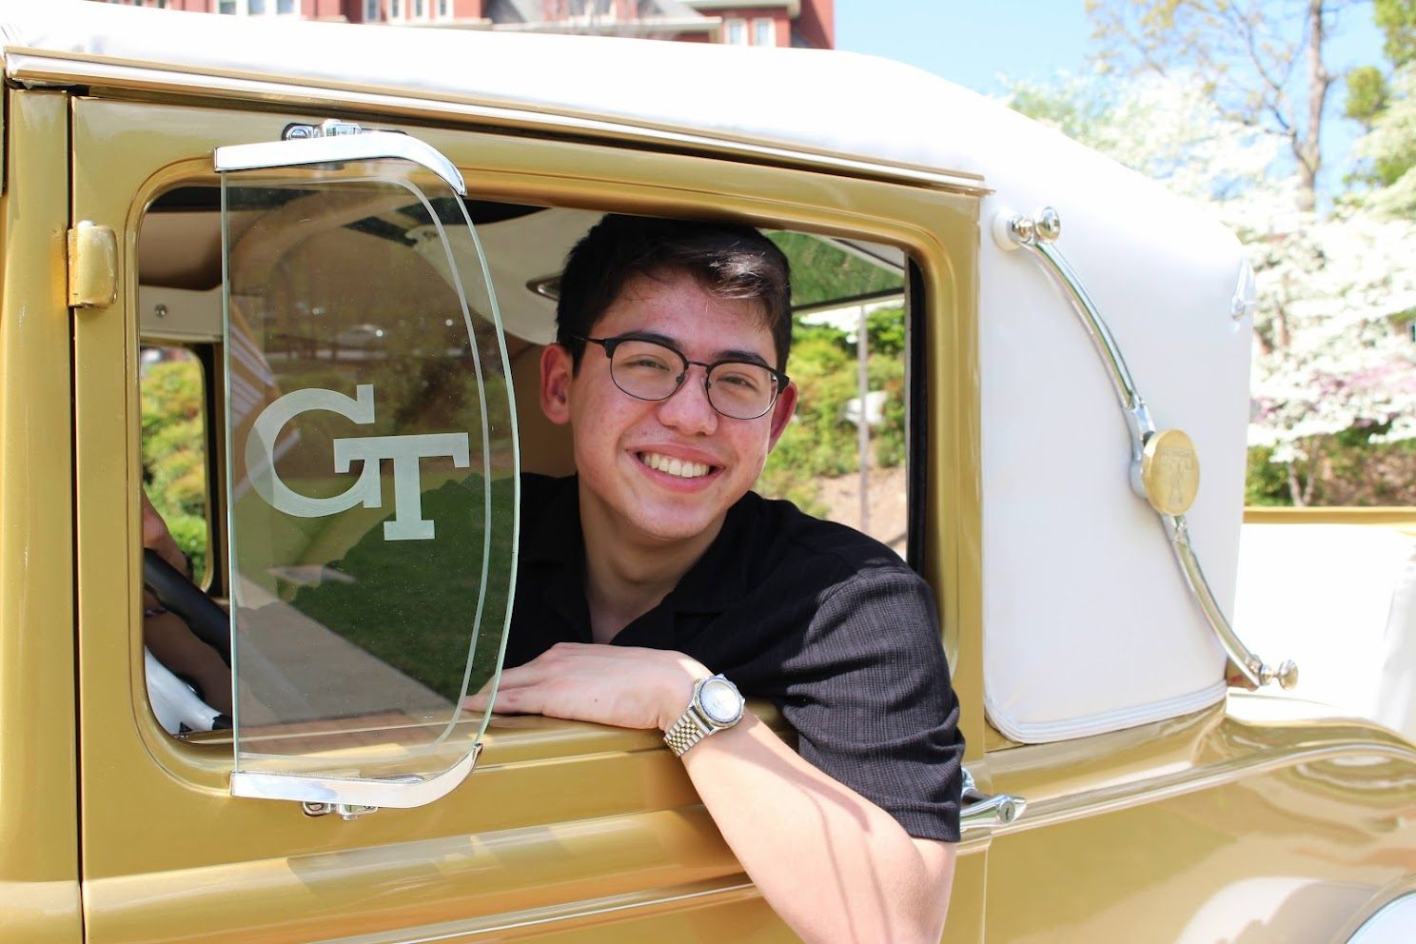
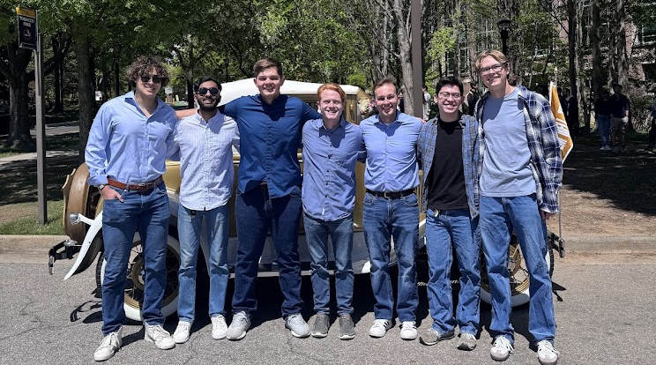
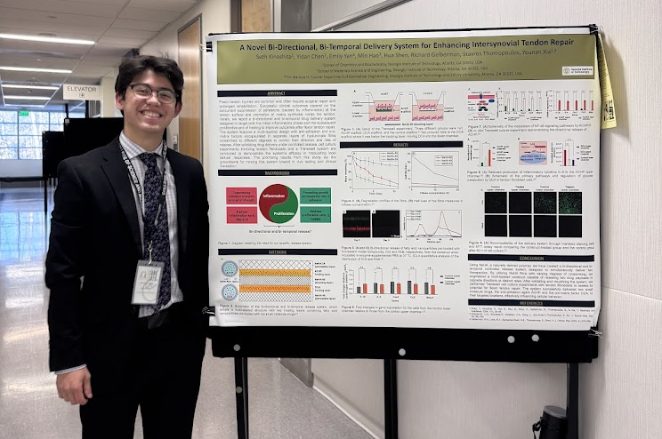
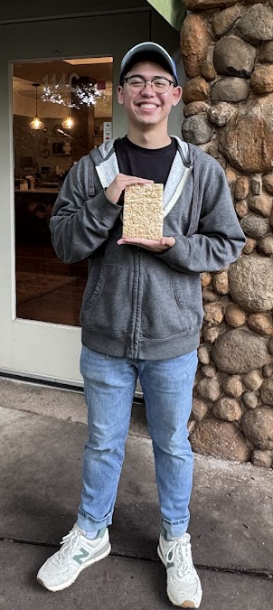
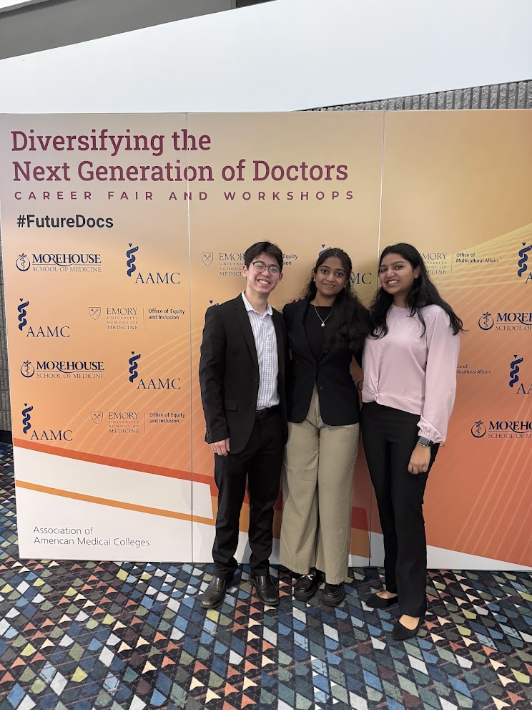
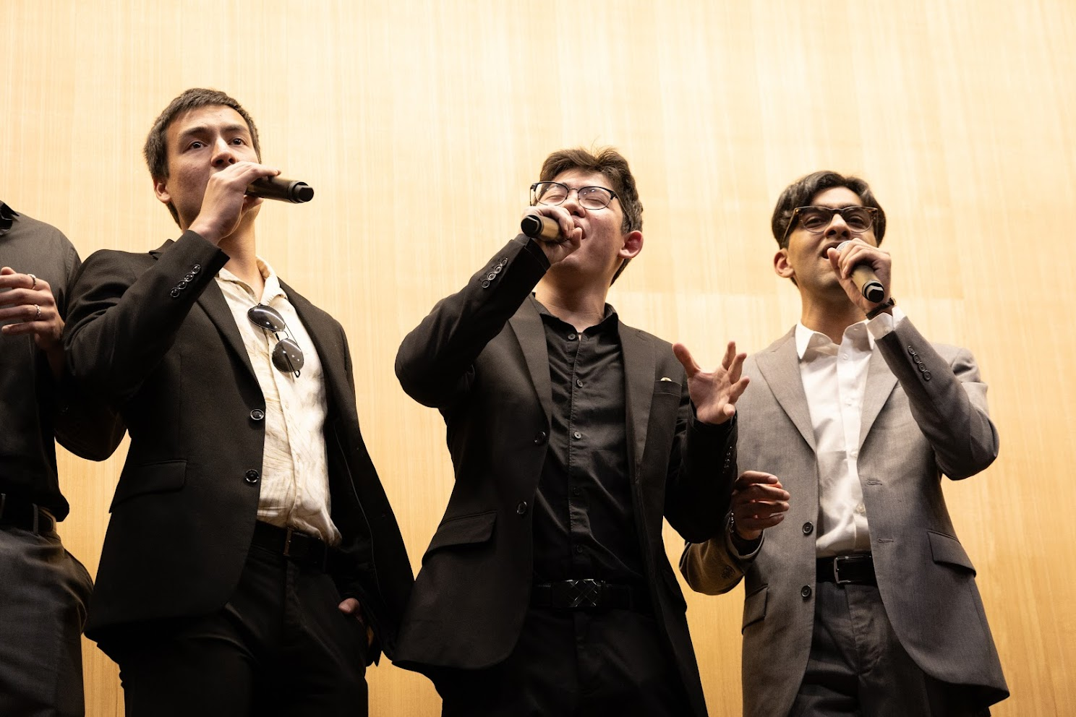
Seth Kinoshita
4th year Biochemistry major with a minor in HMED
Pursuing MD/PhD joint degree
Research experience: nanoparticles, drug delivery, organometallic chemistry, analytical chemistry, bioengineering, nanomedicine, STEM education, orthopedics
Outside of research: working out, photography, singing, golfing

Slide 23
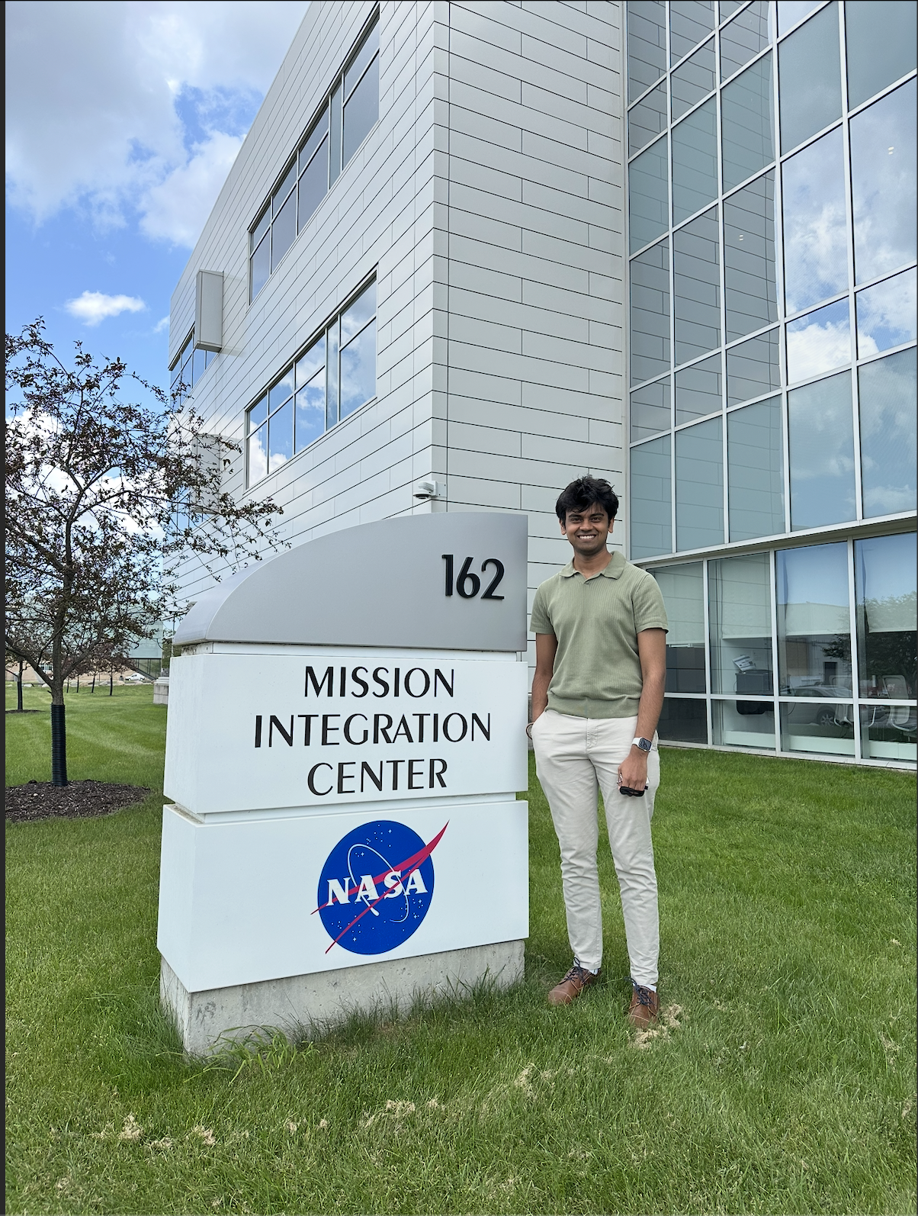
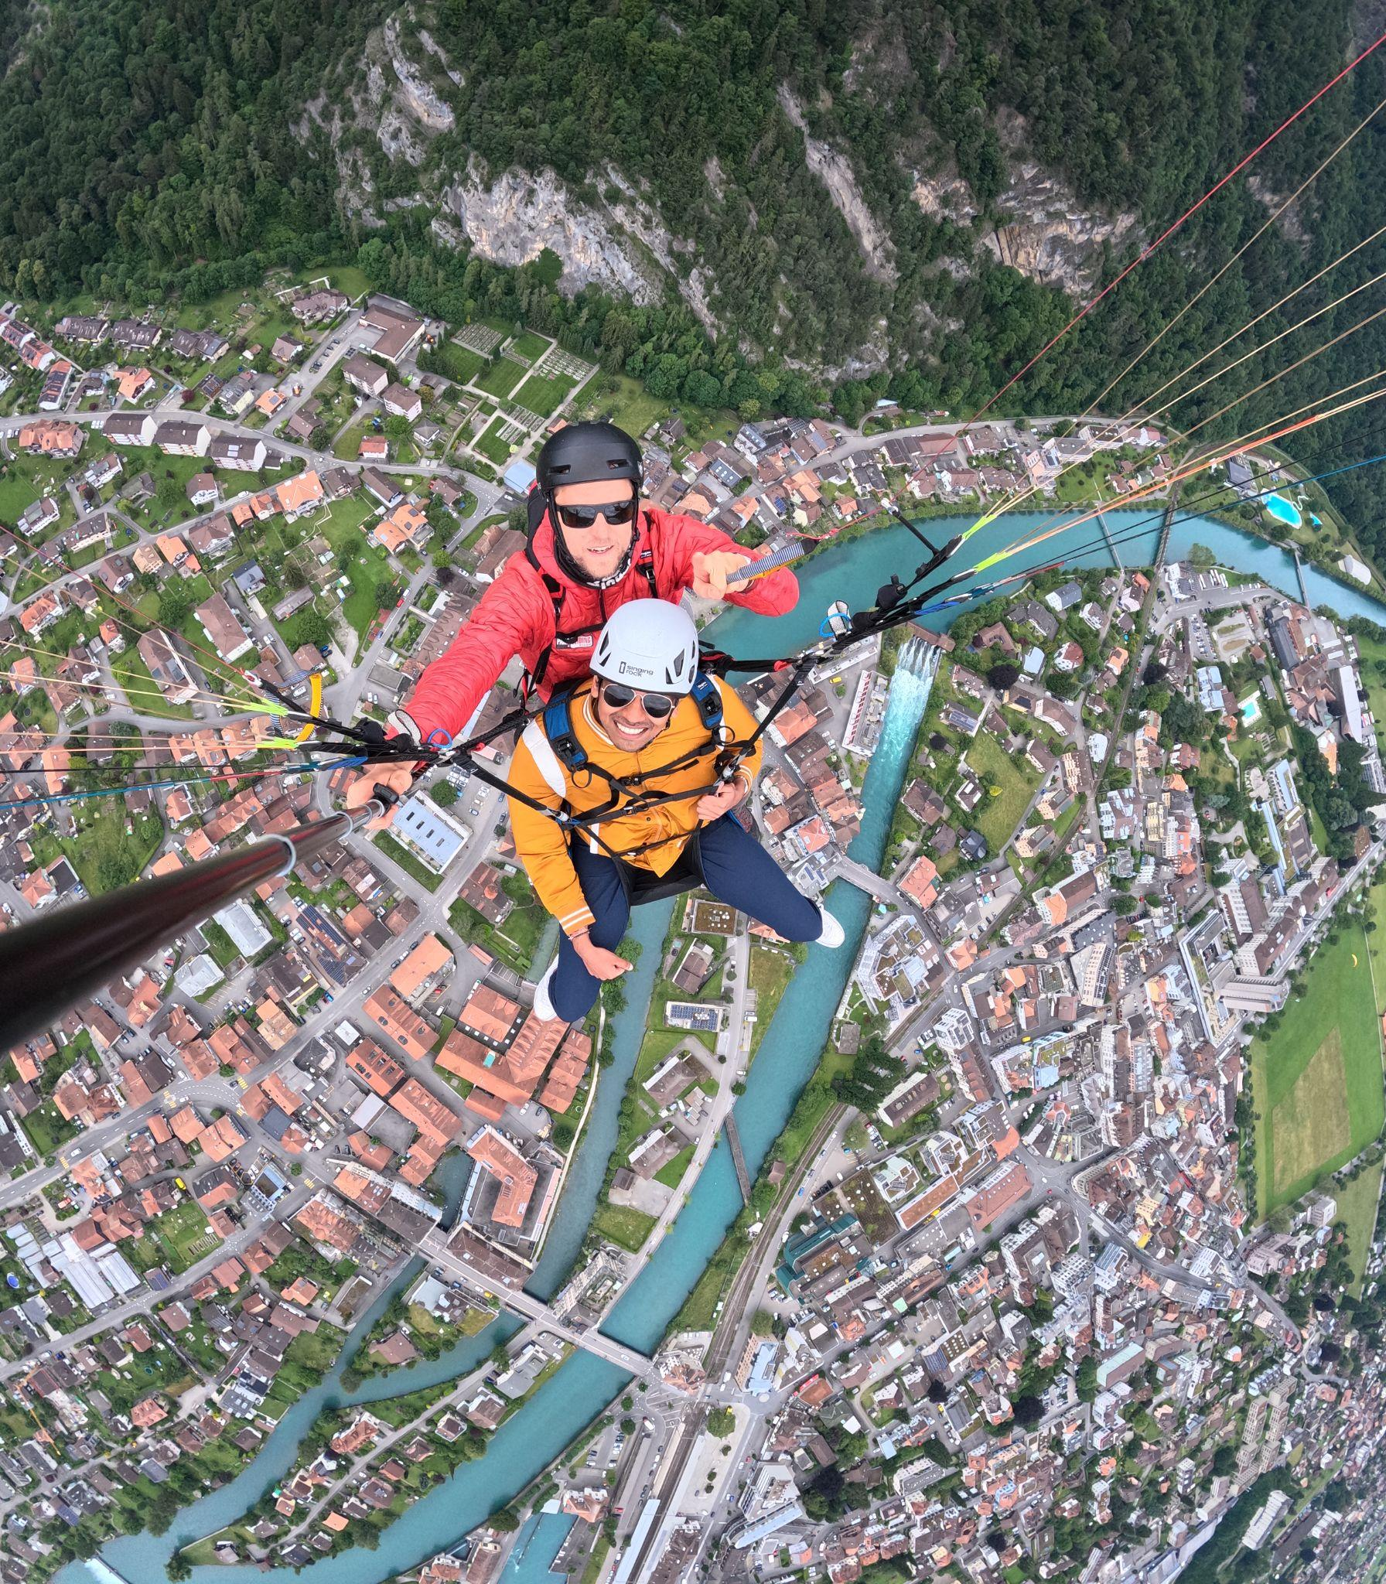
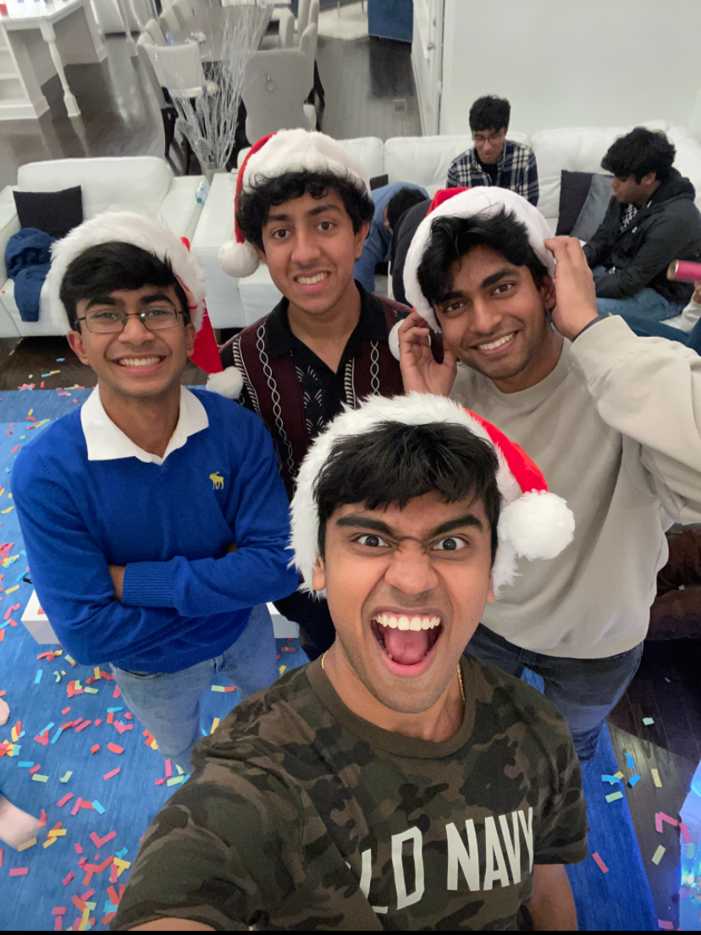
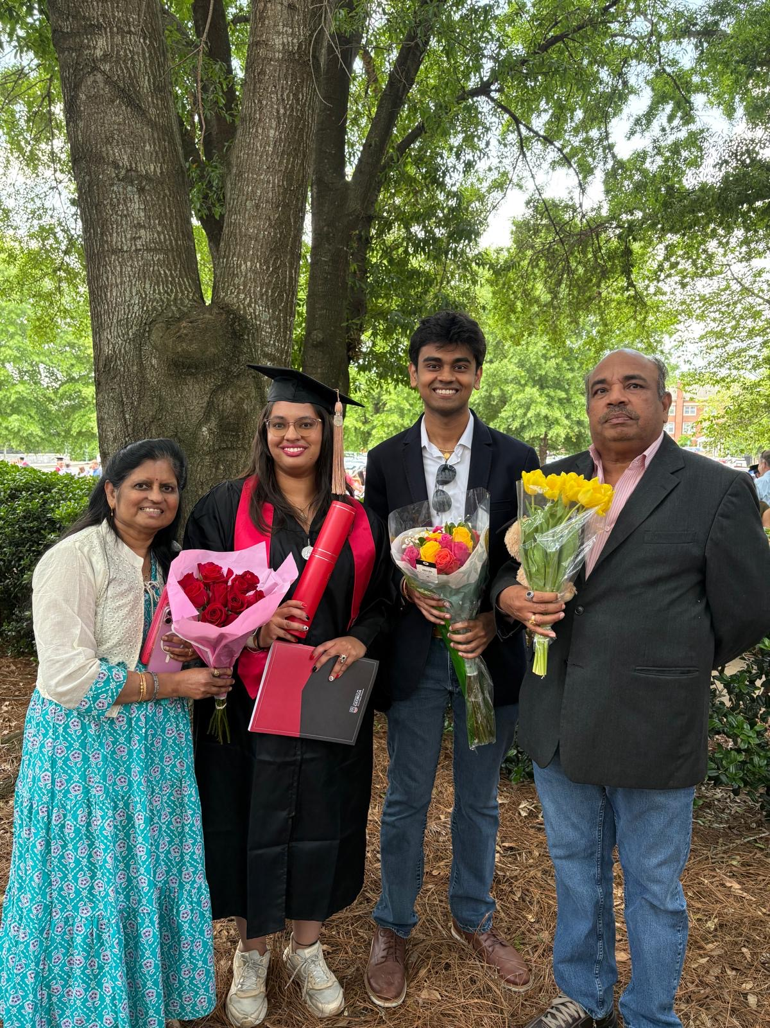
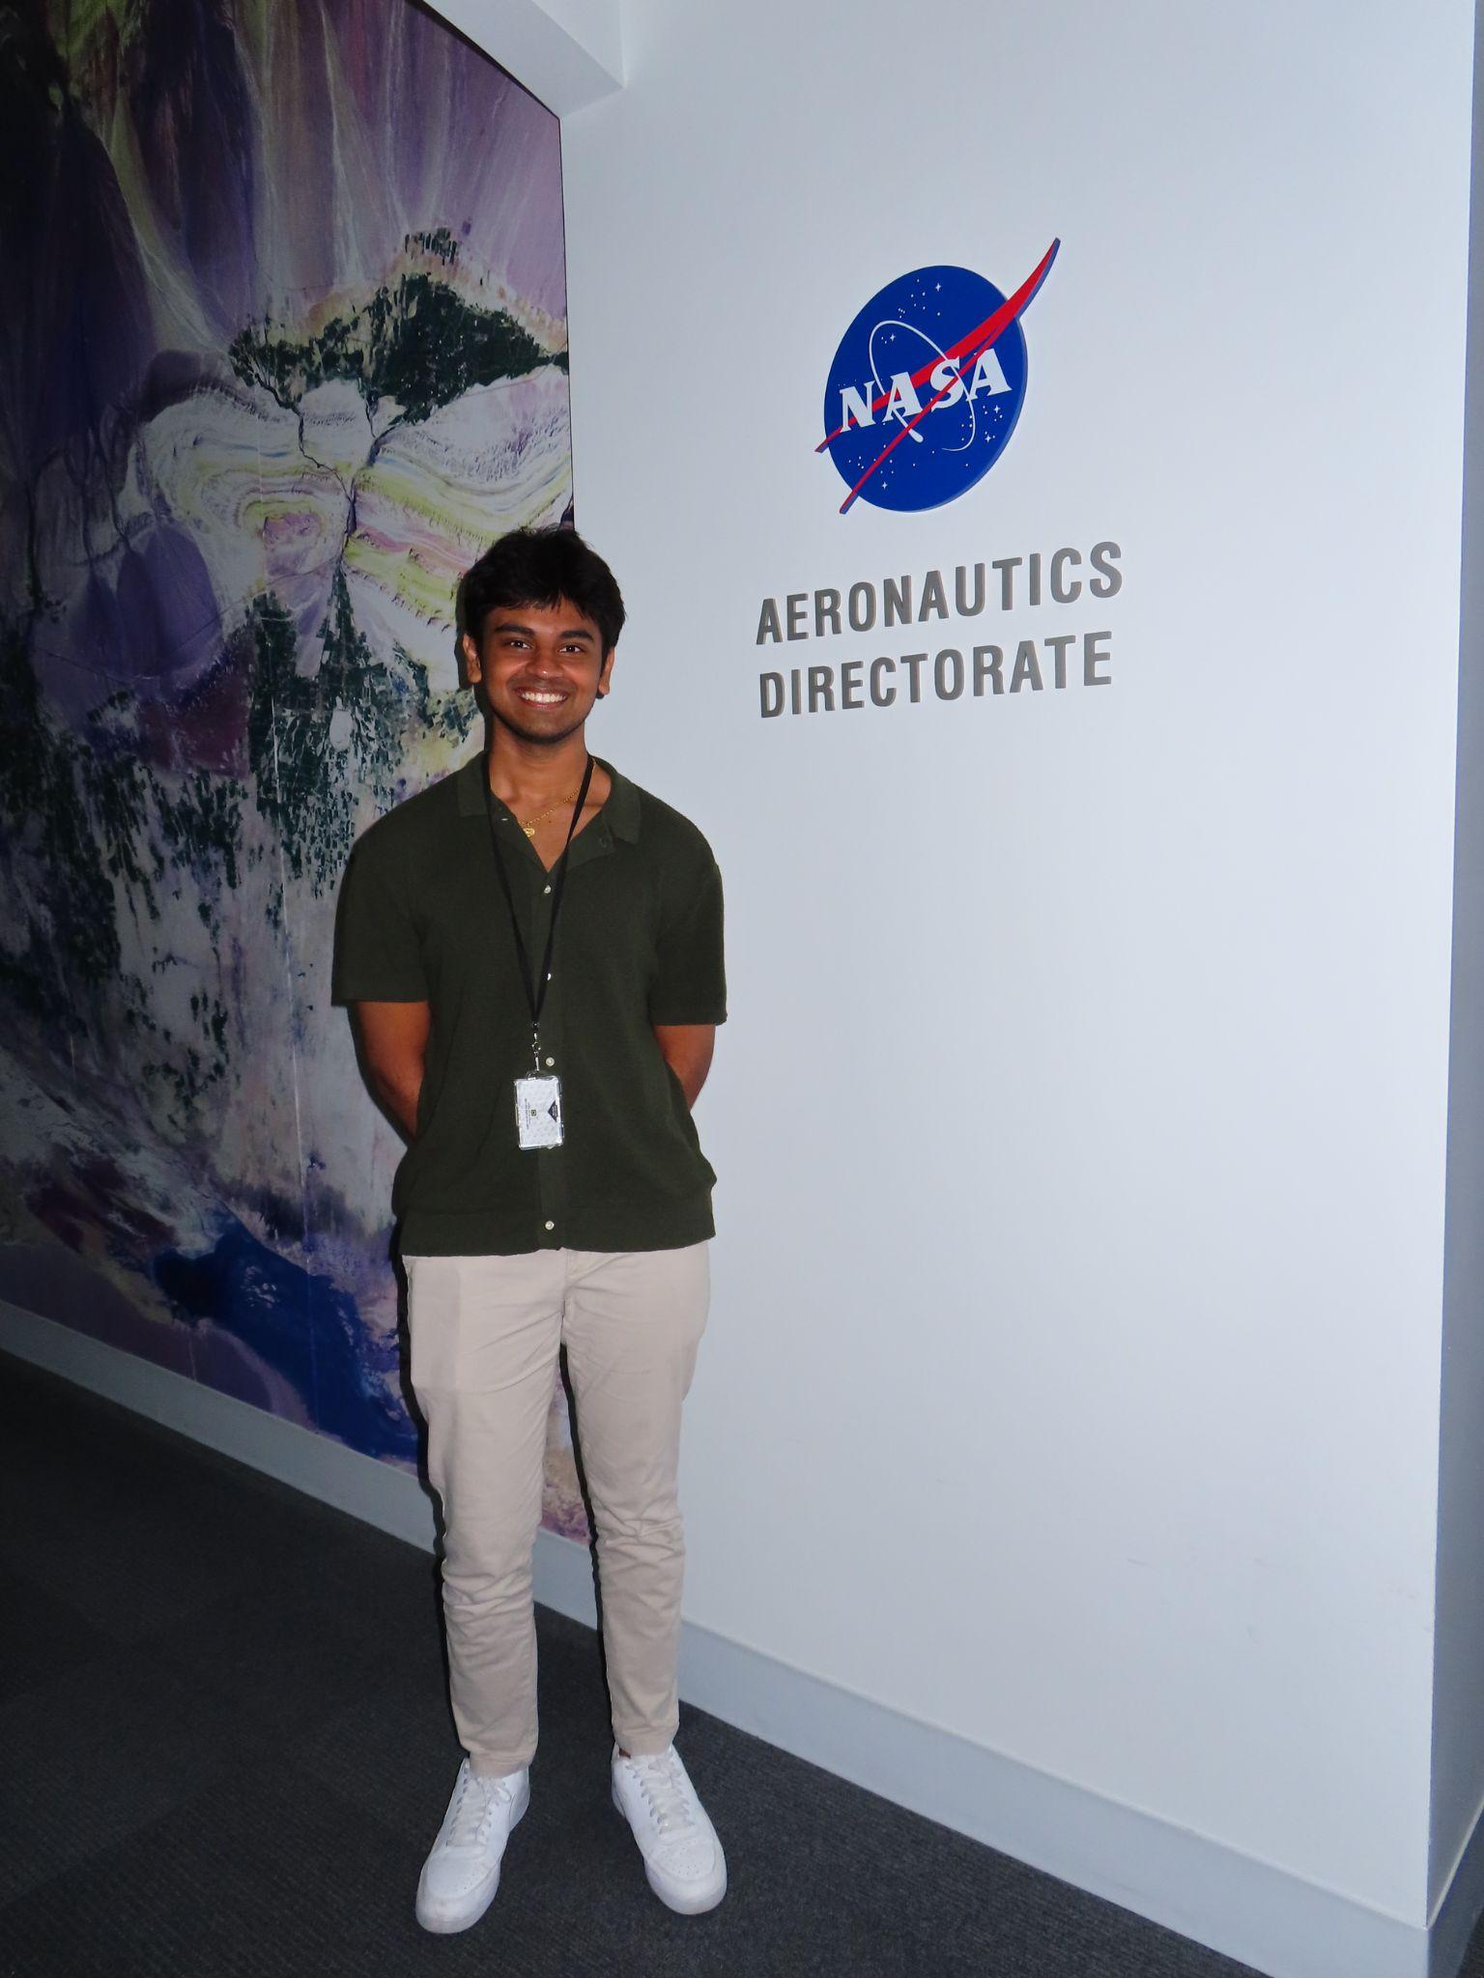
Karthik Chilakapati
3rd year Aerospace Engineering
BS/MS Aerospace Track
Research Experience:
VIP: Martian Advanced Rover Systems (MARS)
Aerospace Systems Design Laboratory (ASDL): System Modeling Model-Based Systems Engineering (MBSE) projects with SysML
Other experiences:
Study Abroad
NASA Internship in MBSE

Slide 24
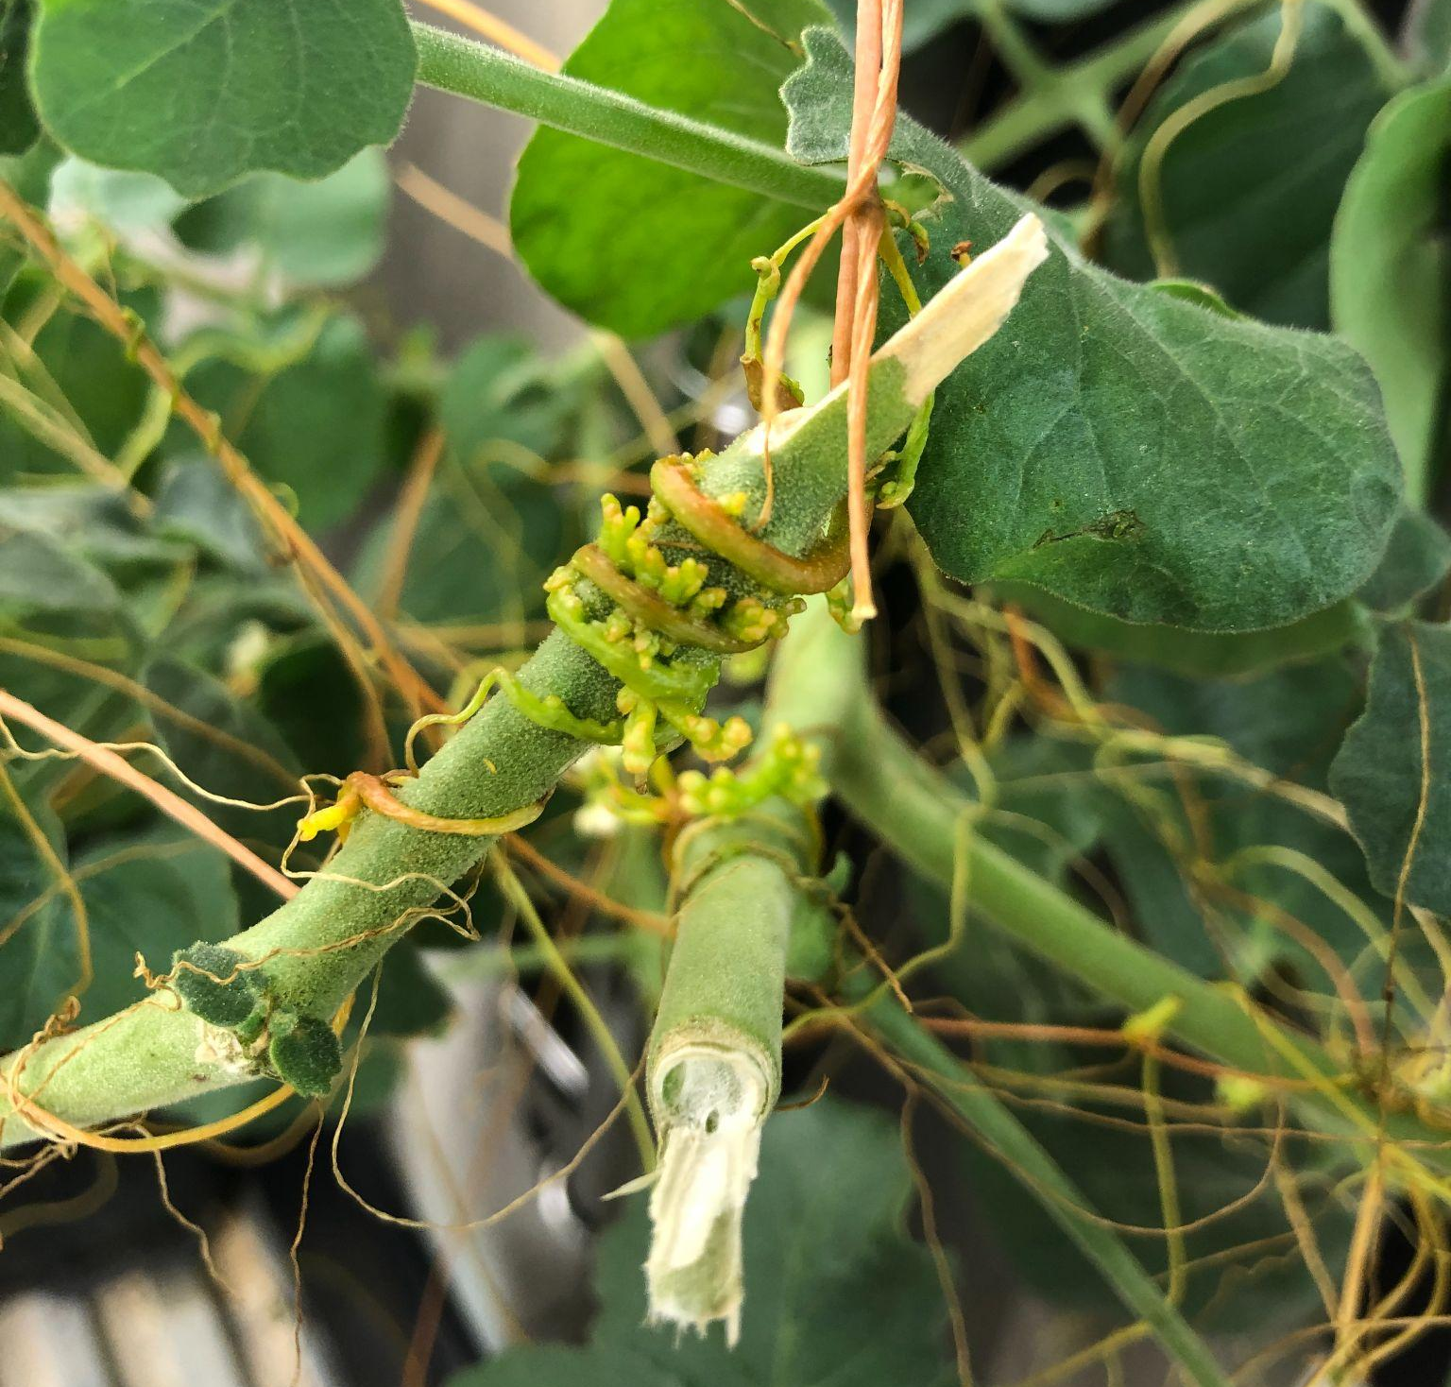
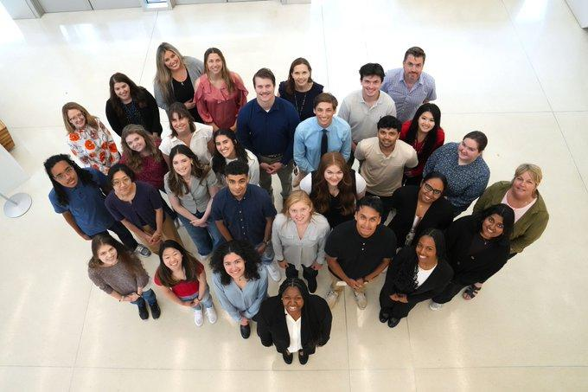
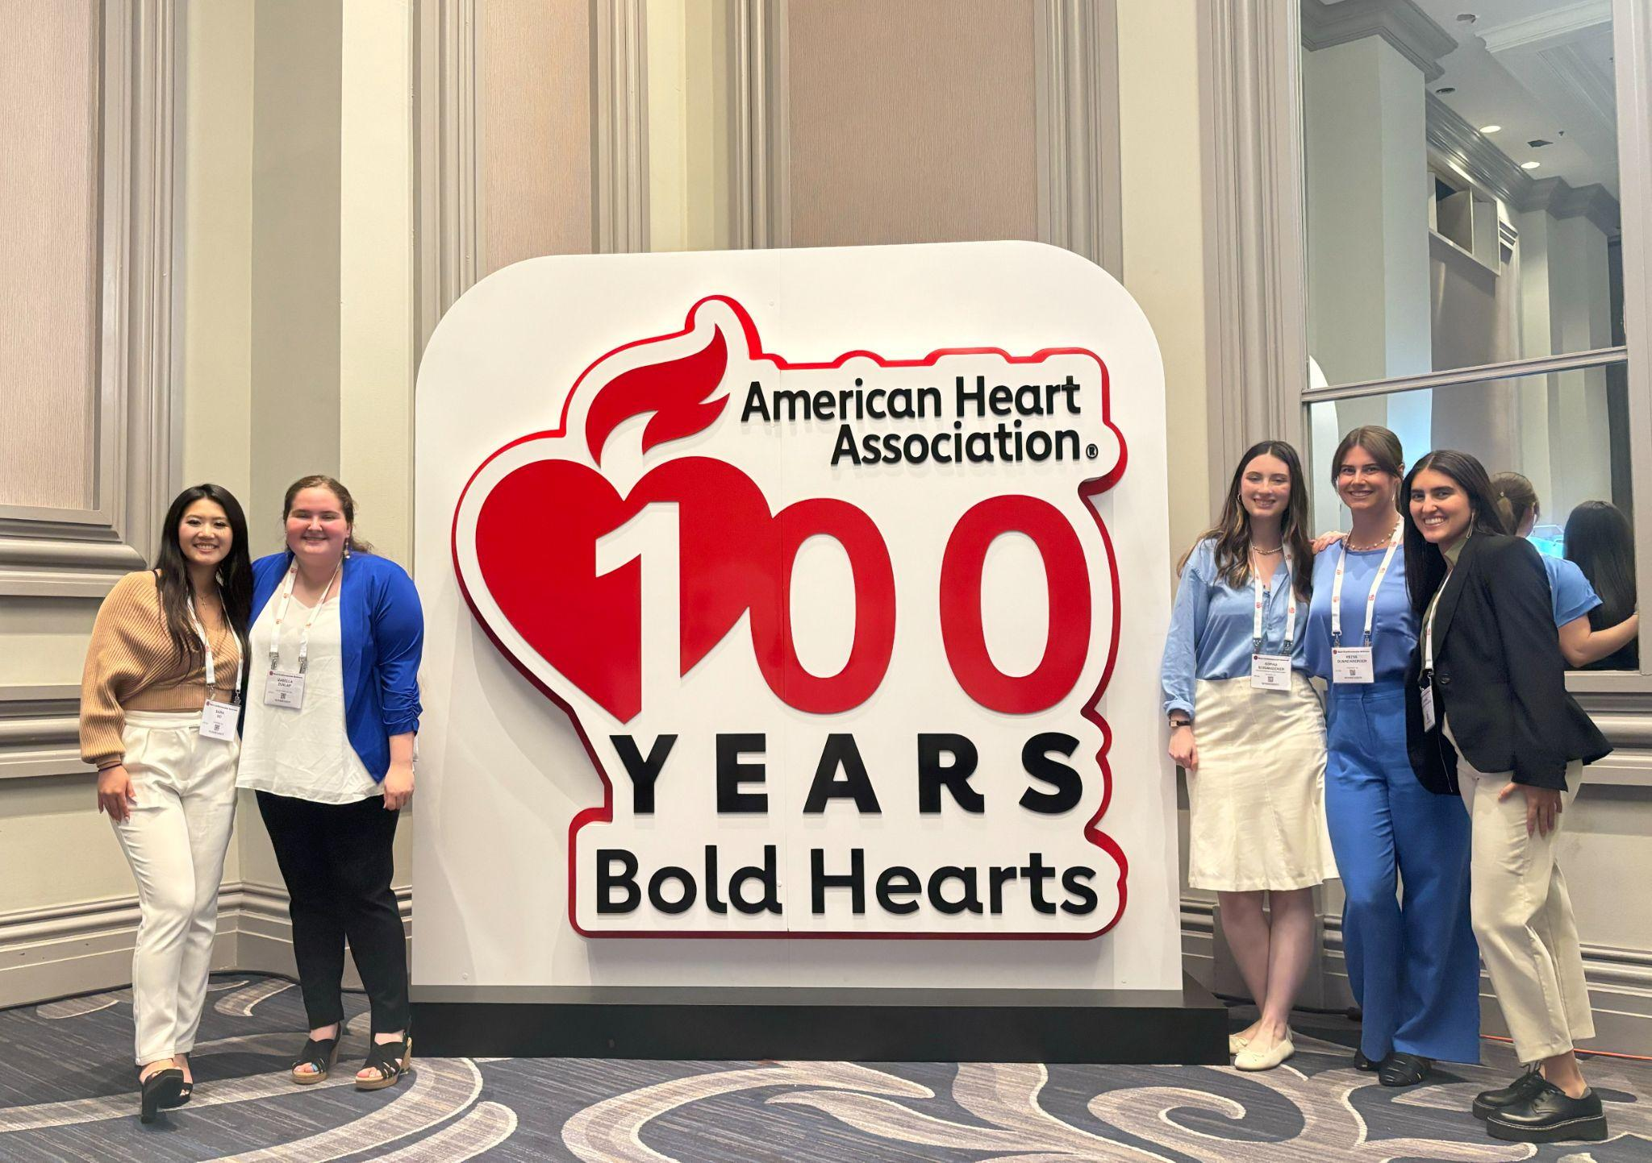
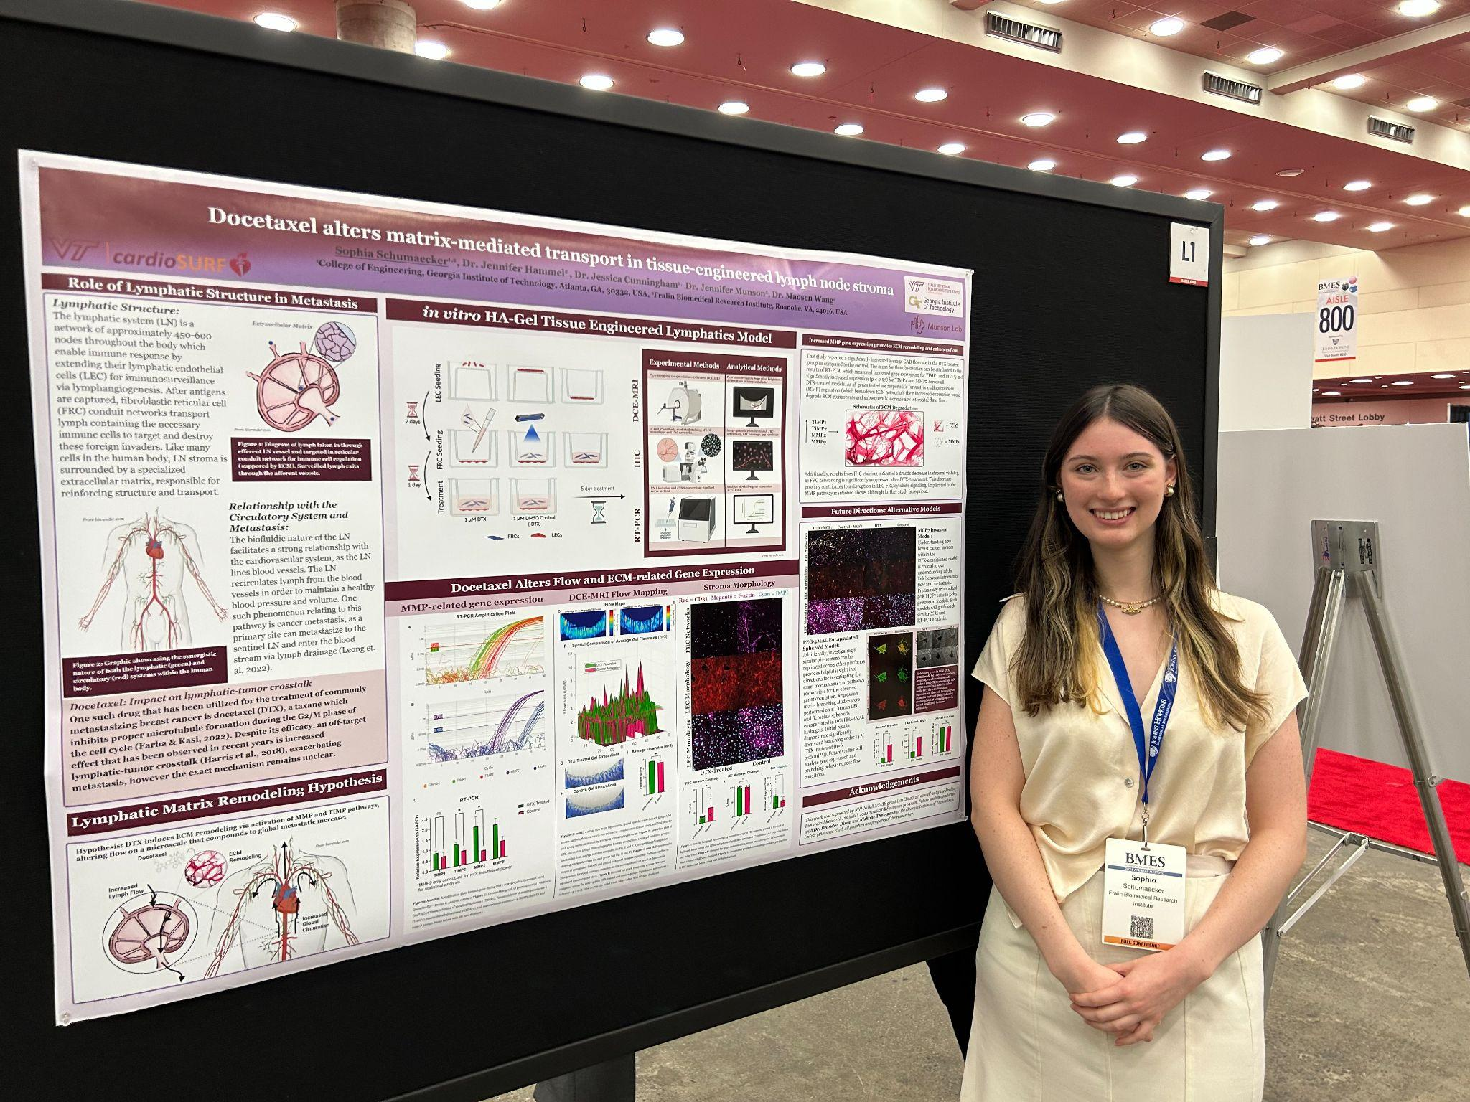
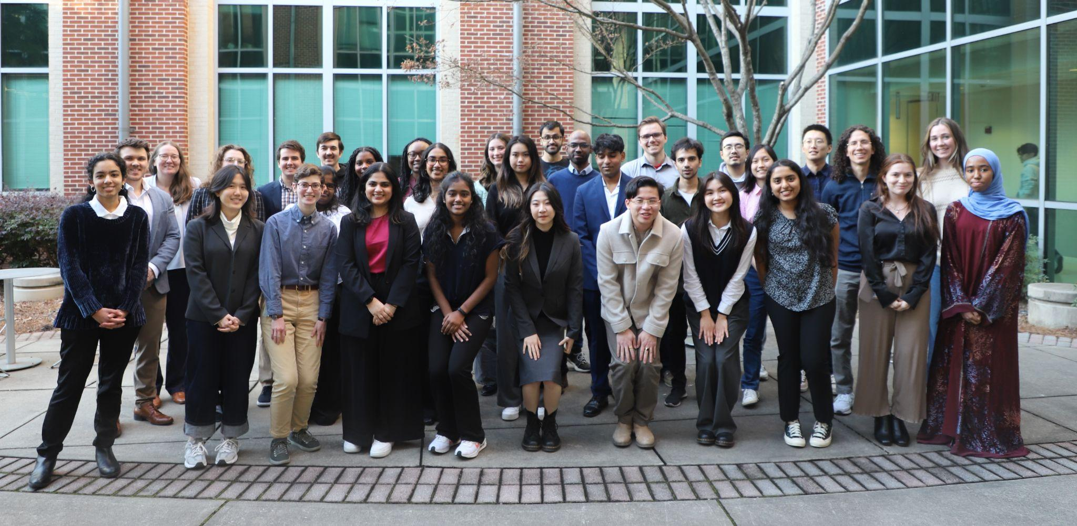
Sophia Schumaecker
3rd year Chemical and Biomolecular Engineering (Biotechnology option) with minor in Spanish
PhD Track
Research Experience:
Laboratory of Lymphatic Biology and Bioengineering (looking at transport and drug delivery in the lymphatic system)
Also worked in a parasitic plant lab and an Oncoengineering lab
Summer experiences:
CardioSURF Summer Research Program
Petit Scholars

Slide 25

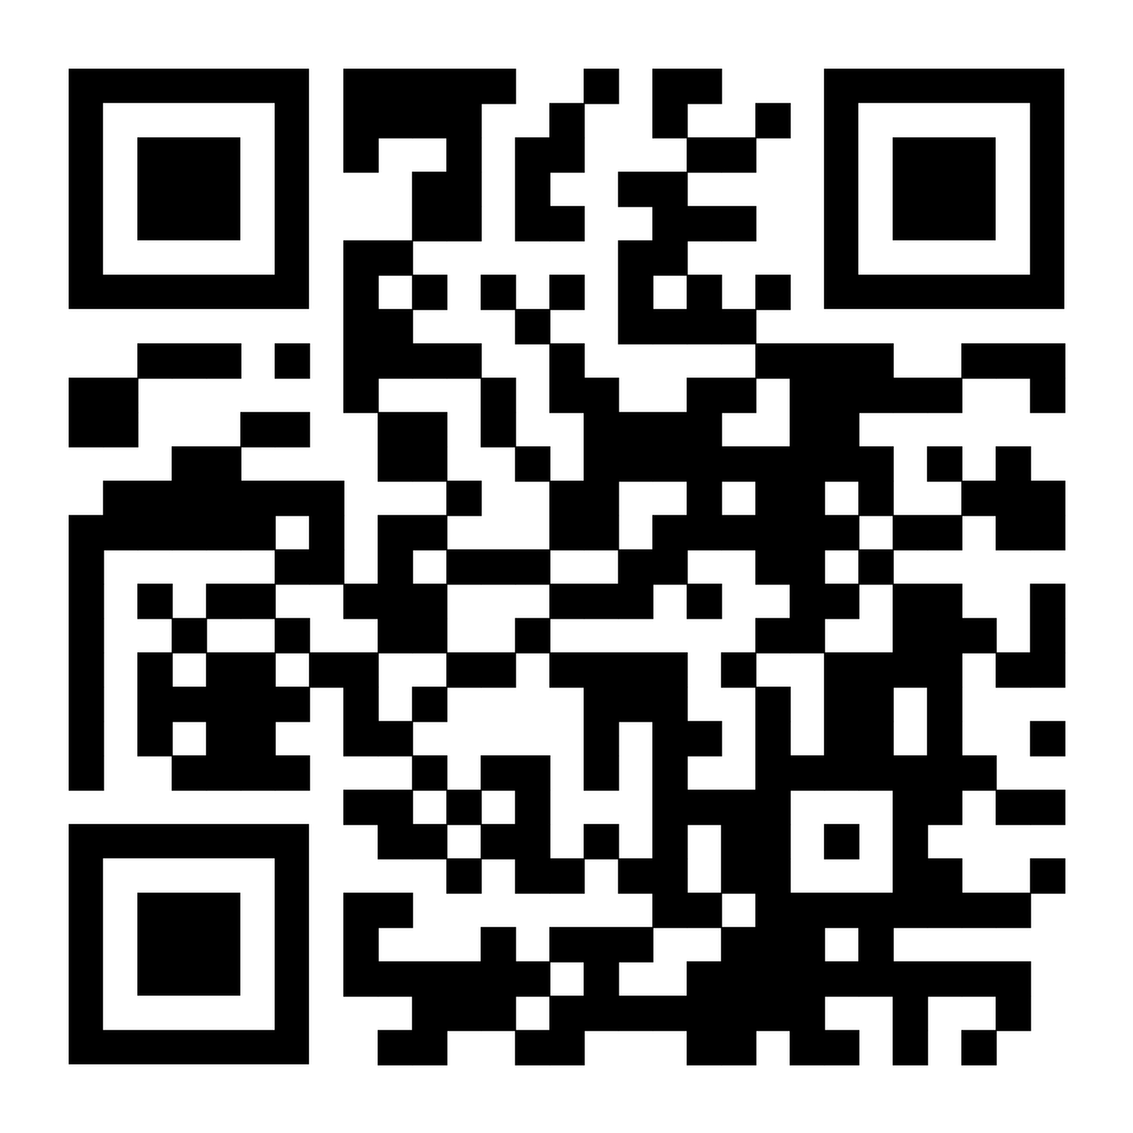
UROP Event Tomorrow!
Discover more about research like Vertically Integrated Projects (VIP)!
More UROP Events

Slide 26
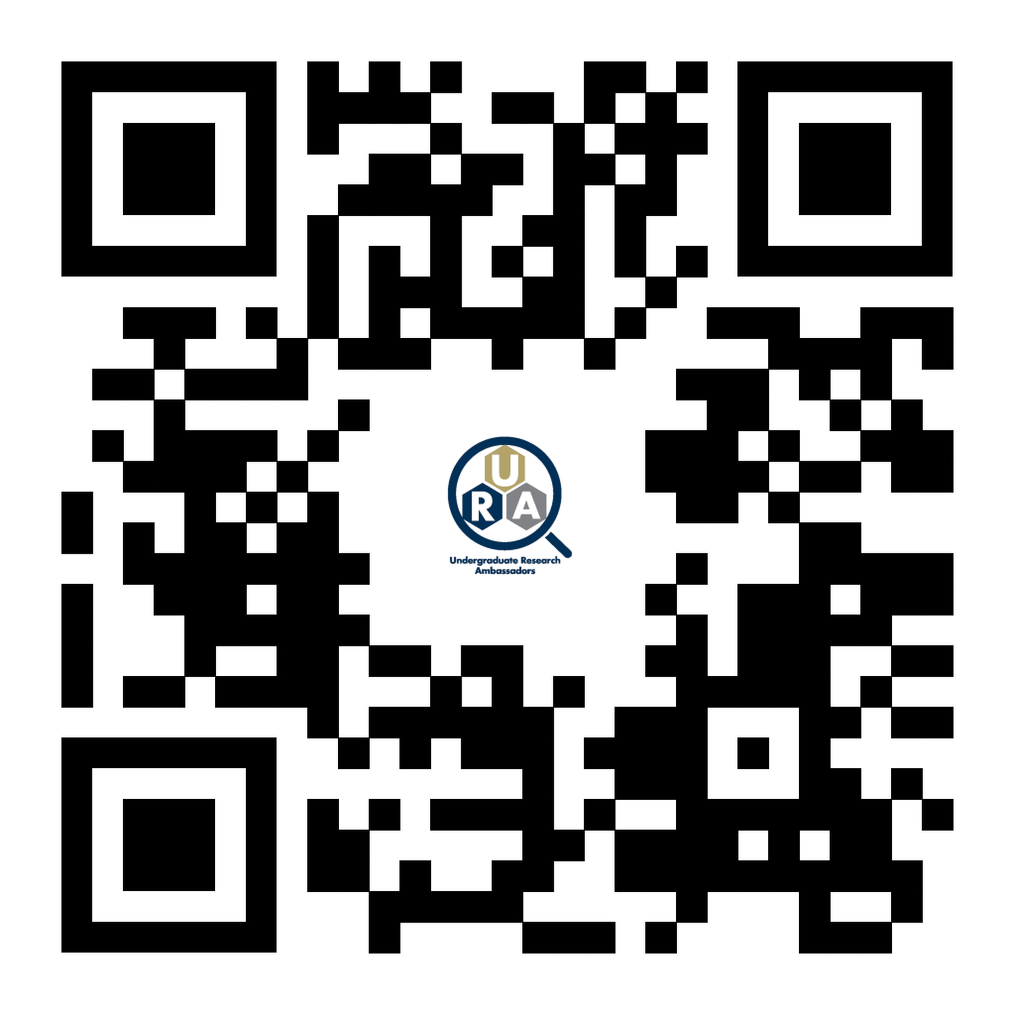

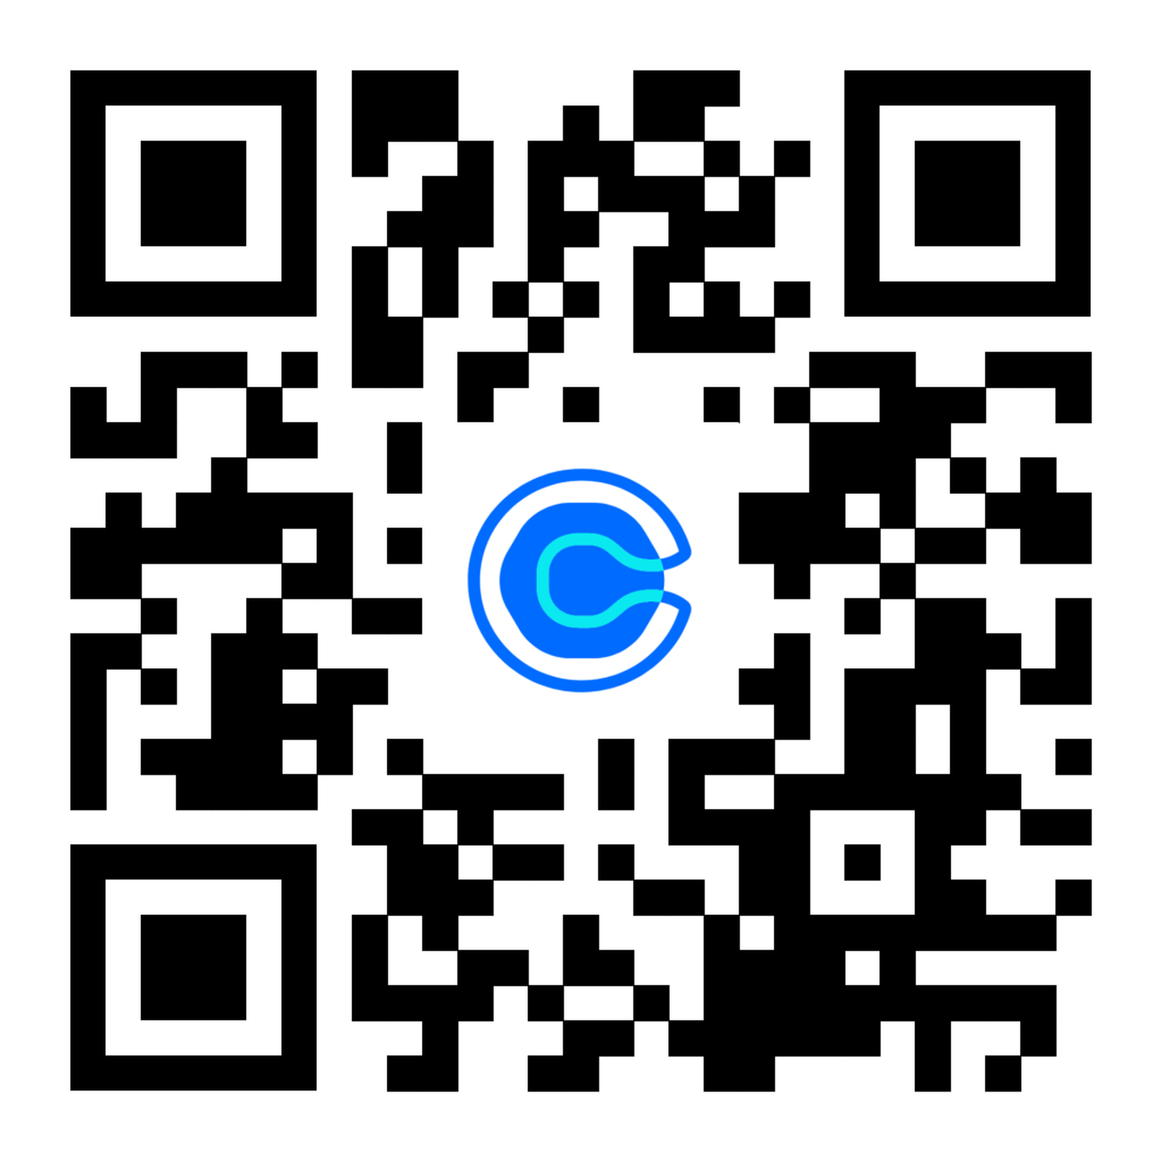
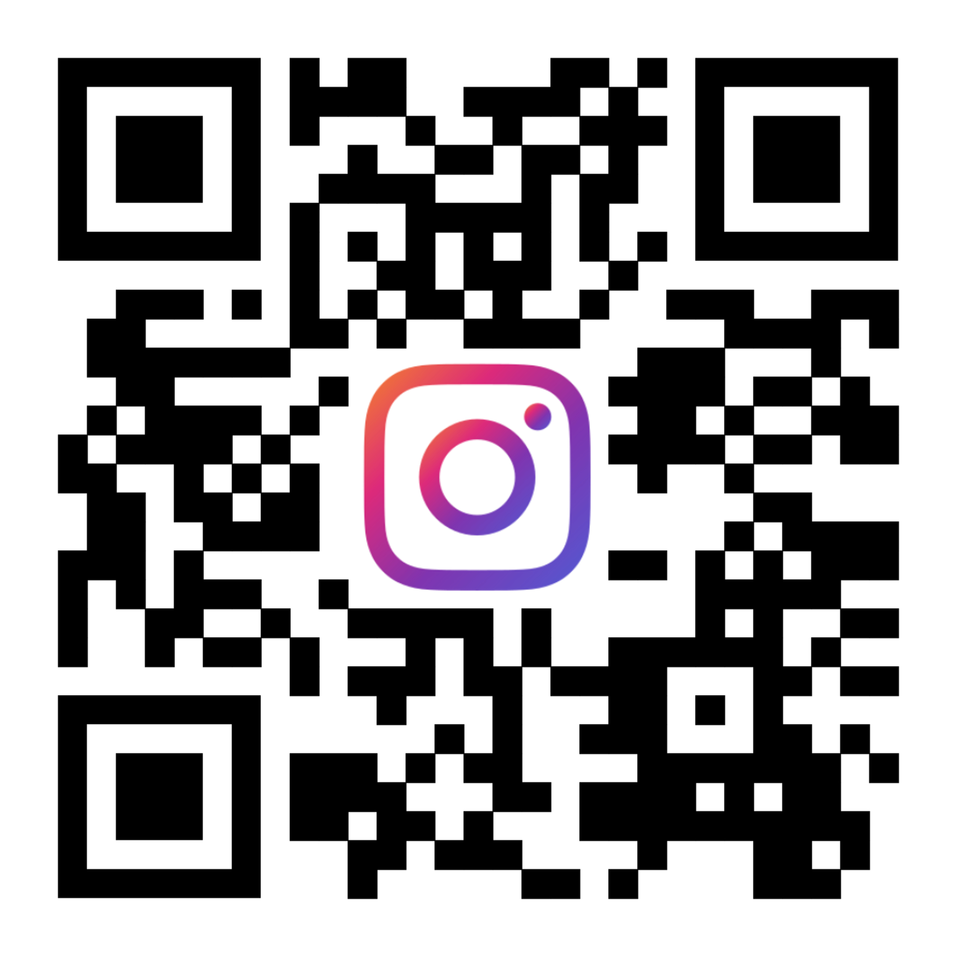
FIND MORE ONLINE
UROP.GATECH.EDU
Undergraduate Research Ambassadors
OFFICE HOURS
Calendly!!
calendly.com/uragatech
INSTAGRAM
@GT_URA

